Slide 1
Constraint-based Decision Optimization 101
An Introduction for the Line-of-Business
Yianni Gamvros (WW tech sales lead, IBM Decision Optimization)
Susara van den Heever (Program Manager, IBM Decision Optimization)
Alkis Vazacopoulos (CEO, Optimization Direct (IBM Partner))

Slide 2
Why Optimization?
“Plans are nothing; planning is everything” – Dwight D. Eisenhower

Slide 3
What is the difference between industry leaders?
vs.
vs.
vs.
vs.
vs.
vs.
Source: The Optimization Edge, Steve Sashihara (New York, NY: McGraw Hill, 2011) p. 3
3

Slide 4
Optimization solutions – documented ROI
2 Chilean Forestry firms | Timber Harvesting | $20M/yr + 30% fewer trucks
UPS | Air Network Design | $40M/yr + 10% fewer planes
South African Defense | Force/Equip Planning | $1.1B/yr
Motorola | Procurement Management | $100M-150M/yr
Samsung Electronics | Semiconductor Manufacturing | 50% reduction in cycle times
SNCF (French RR) | Scheduling & Pricing | $16M/yr rev + 2% lower op ex
Continental Airlines | Crew Re-scheduling | $40M/yr
AT&T | Network Recovery | 35% reduction spare capacity
Grantham Mayo van Otterloo | Portfolio Optimization | $4M/yr
Source: Edelman Finalists, http://www.informs.org or http://www.scienceofbetter.org

Slide 5
Hard Benefits of Optimization
Calculable ROIs, paybacks within months, sometimes even weeks
Capital expense avoidance or deferral
Operating expense reductions
Total revenue, revenue mix, and margin improvements
Improved customer satisfaction
Provide better and more customized customer service
Reduce costs; improve customer service
Improved operations
Increase productivity
Better planning and scheduling processes
Minimize Costs, Maximize Profits

Slide 6
What is Decision Optimization?

Slide 7
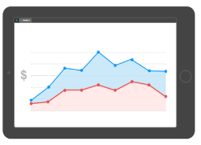
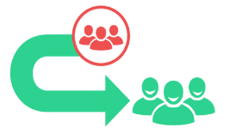
The advanced analytics picture
IBM’s Advanced Analytics Portfolio
Descriptive Analytics
Predictive Analytics
Prescriptive Analytics
What is happening in my business today?
What will happen in the future?
What should I do about it?

Slide 8
The advanced analytics picture
Decision Optimization is the “secret sauce” of Prescriptive Analytics
IBM’s Advanced Analytics Portfolio
Descriptive Analytics
Predictive Analytics
Prescriptive Analytics
What is happening in my business today?
What will happen in the future?
What should I do about it?

Slide 9
Business Analytics and Optimization
Stochastic Optimization
Prescriptive
Optimization
Predictive Modeling
Predictive
Forecasting/ Extrapolation
Statistical Analysis
Competitive Advantage
Alerts
Query/ Drill Down
Descriptive
Ad hoc reports
Standard Report
Complexity
9
From the book “Competing on Analytics” by Thomas H. Davenport , Jeanne G. Harris

Slide 10
Decision Support Applications
Key steps for a mature decision support application leveraging advanced analytics
Historical & Master Data ETL
Predictions and Insights
Rules & Process
Management
Collaboration & What-if
Decision Making
Capture price, product, location and date for each transaction.
Determine important variables, predict trends, seasonality etc.
Set policies, promotions etc. Allow reviewers and auditors to have a say.
Allow multiple users to experiment with multiple scenarios.
Automatically generate decisions, allow user interaction with decisions.
Descriptive
Predictive
Prescriptive

Slide 11
Prescriptive Analytics by Industry

Slide 12
Indeval (Mexican Central Securities Depository)
Challenge
Process security transactions in real-time rather than daily.
Provide a better service to the Mexican Stock Exchange.
Profile
Solution
A private securities depository organization in Mexico.
Decision Optimization for assignment and scheduling
Benefits/ROI
Testimonial
Real time reconciliation and completion of trading operations for more than USD$250 B in average, every day
Reduced liquidity requirements for trading partners by 52 percent
Increased the volume of operations by 26 percent
Reduced the costs of each trading transaction for electronic trading facilities, the Stock Exchange and trading brokers
“By building a unique technology solution for our securities services, we now better serve the Mexican Financial Community and trading partners. We are very proud that this solution has played a key role in helping elevate the economy of Mexico.”
Jaime Villaseñor
Chief Risk Officer, INDEVAL
Notes:
12
Steve Mills
09/15/10
100915 MILLS WebSphere eCommerce Forum Toronto.ppt
12
12
Not in CRMD

Slide 13
Auditing Tax Returns at New York State
Challenge
Questionable tax refunds can total about $400-500M.
98,000 exception returns are processed.
800-1200 people analyze exceptions.
Solution
BPM for process automation
SPSS predictive analytics for scoring
Decision Optimization for assignment and scheduling
Benefits/ROI
Increased collections of outstanding debt by $83M
Average age of cases when assigned to field agents decreased by 9.3%
Dollars per staff day increased by 15%
35,000 fewer taxpayers had serious enforcement actions taken against them.
Collections process is more productive, efficient and fairer to all taxpayers.
Profile
New York State
20M total population
~$200B total state tax revenue (third highest)
Notes:
13
Steve Mills
09/15/10
100915 MILLS WebSphere eCommerce Forum Toronto.ppt
13
13
Not in CRMD

Slide 14
Flash Memory Supplier Management
Challenge
Place orders for flash memory from manufacturers
Determine how memory will be used. Which product line, which market and which assembly shop will utilize provided raw materials.
Initial 4 week freeze period. 4-8 weeks of limited flexibility. 8-52 week of full flexibility.
Constant changes in the market, technology and suppliers
Solution
Excel spreadsheets were replaced by dedicated optimization solution for supplier planning
Solution allowed for freeze period, limited flexibility and full flexibility periods.
Customer Profile
Benefits/ROI
Planning team can now collaborate on a global plan
Consistency in decision making
Audit capability on old plans
Global consumer electronics retailer
Multiple markets, multiple product lines, multiple suppliers
Multiple global suppliers
Notes:
14
Steve Mills
09/15/10
100915 MILLS WebSphere eCommerce Forum Toronto.ppt
14
14

Slide 15
Detailed Scheduling, Monitoring and Re-Scheduling
Challenge
Increasing complexity in the Final Assembly Line
Volatile market demand
Tough competition, pressure on costs & on time deliver
Need to Increase productivity, utilization and efficiency.
Ability to manage unforeseen event during production
Capitalize very experienced planners expertise
Solution
IBM ILOG optimization solution to schedule, monitor and re-schedule production.
Complementing SAP
Delivering understandable and executable schedule in minutes with the capability to plan activities, outstanding work, and manage unexpected events that can build a detailed schedule in a few minutes.
Ability to monitor progress and re-schedule on demand
Benefits/ROI
Customer Profile
One unique tool for all Final assembly lines for all AIRBUS aircraft families
Starting deployment for aircraft component
Planning effort reduced from 7 days to 3-4 hours.
Re-scheduling in minutes
Airbus is a leading aircraft manufacturer whose customer focus, commercial know-how, technological leadership and manufacturing efficiency have propelled it to the forefront of the industry.
Notes:
15
Steve Mills
09/15/10
100915 MILLS WebSphere eCommerce Forum Toronto.ppt
15
15
Problem/Situation
An increasing complexity in the Final Assembly Line
Aircrafts are getting more and more sophisticated and complex - 8 000 tasks to schedule on A380 station 30 (dedicated to all tests of an aircraft
Market demand is changing (increasing 3 years ago, decreasing today)
Tough competition with Boeing - product costs & capability to deliver on time
Profitability is a challenge
Goals
Increase the productivity by optimizing resources
Increase/decrease production rate
Make planning quality independent from planner experience
Benefits from a decision support system
Capability to plan activities, outstanding works & manage unexpected events
Monitor work progress and completion
Solution
A visual, ergonomic and powerful planning tool running on a standard PC that can build a detailed schedule in a few minutes
A tailored solution using all ILOG technologies - Optimization, Business Rules and Visualization- delivered by ILOG PS and fully integrated with SAP
Benefits
Harmonization across all AIRBUS aircraft program, One common tools for all aircraft families!
User friendly tools accepted by all Final Assembly Line planners. Planning effort drastically reduced.
The Best manufacturing know-how of the most experienced people capitalized within the application; Many master data errors fixed thanks to AVL2
All the business and IT expectations are met.

Slide 16
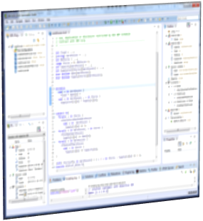
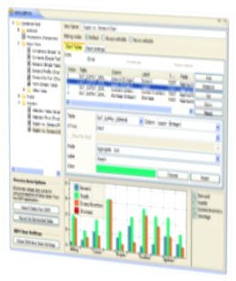
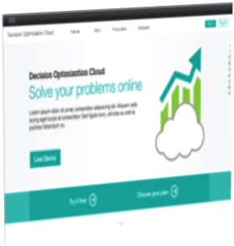
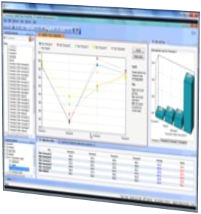
IBM Decision Optimization portfolio
Market Leading MP & CP Optimization Engine
Application Development Platform
Build optimization solutions.
Includes data analysis & visualization,
scenario management, collaborative planning, and what-if analysis
(DOcenter, COS).
Model complex business problems.
Solve with IBM CPLEX Optimizer.
Prescribe precise and logical decisions.
Advanced Tools for
Optimization under Uncertainty
SaaS Delivery via Decision Optimization on Cloud
Prescriptive analytics as a service.
No install, no setup.
Embed in other applications via Rest API.
http://ibm.co/docloudtrial
Compare multiple plans, scenarios, KPIs.
Understand trade-offs e.g. costs vs robustness.
Improve solution stability/robustness.

Slide 17
How does optimization work?

Slide 18
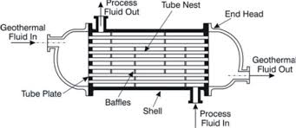
What does a heat exchanger have to do with optimization?
Process Fluid Out
Tube Nest
Piping
End Head Diameter
Geothermal Fluid In
Geothermal Fluid Out
Tube Plate
Material
Baffles
Length
Shell
Material
Process Fluid In

Slide 19
How does optimization work?
… and that allows business users to execute multiple what-if scenarios
What used to take days or weeks can now be achieved almost instantly …
19
Notes:
19

Slide 20
Optimization application development cycle
Define Problem in Business Language
Develop Mathematical Model
Optimization Engine Finds Solution
Analyze / execute solution in LoB environment

Slide 21
What is an optimization model?
A translation of your business problem into “math speak”
Business goals / KPIs
Increase profits
Model objectives
Maximize Profit
Knowns / data
Capacity to produce product A
Demand of product A
Input data
Capacity_A, Demand_A
Unknowns / decisions
How much to produce of A?
Model variables
Prod_A
Business “rules” / constraints
Production of A must be less than plant capacity
Production of A must aim to satisfy demand
Model constraints
Prod_A <= Capacity_A
Prod_A + UnmetDemand_A = Demand_A

Slide 22
Communicating optimization results to your business
Visualization is key!
E.g. Interactive Gantt:
See how inventory graph changes with schedule changes
Allow LoB to “freeze” a subset of activities and re-optimize
Drag-and-drop activities
Automatically check schedule conflicts when making manual changes
Raw material inventory
Intermediate product schedule Gantt
Final product schedule Gantt
“Drag-and-drop” activities
Right click to freeze

Slide 23
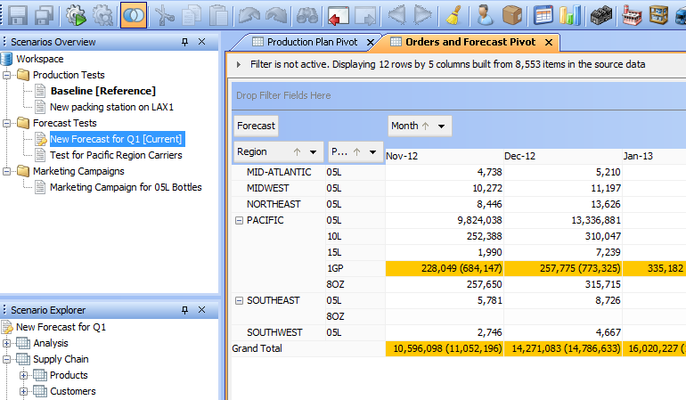
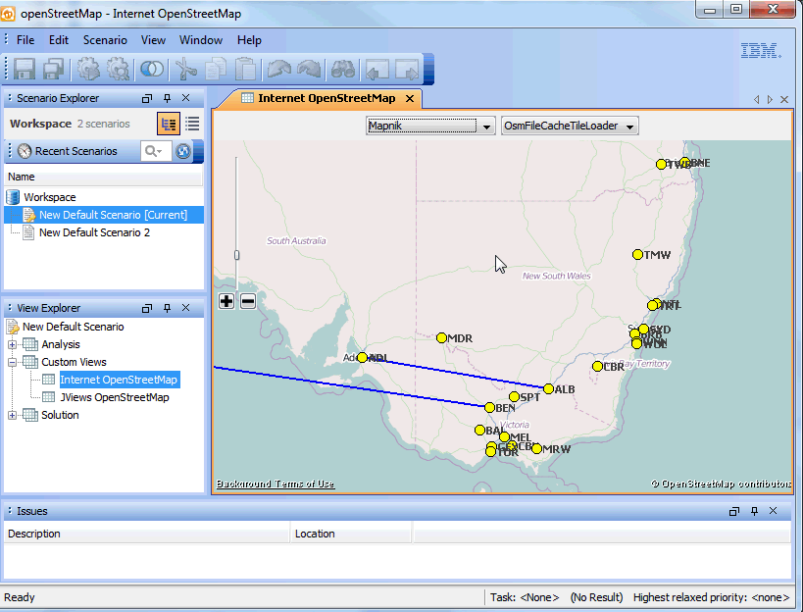
Communicating optimization results to your business
View differences between scenarios
Edit and set priorities on business rules / constraints
Use maps where appropriate

Slide 24
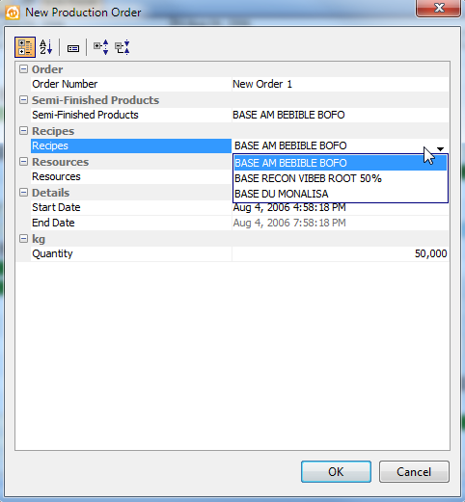
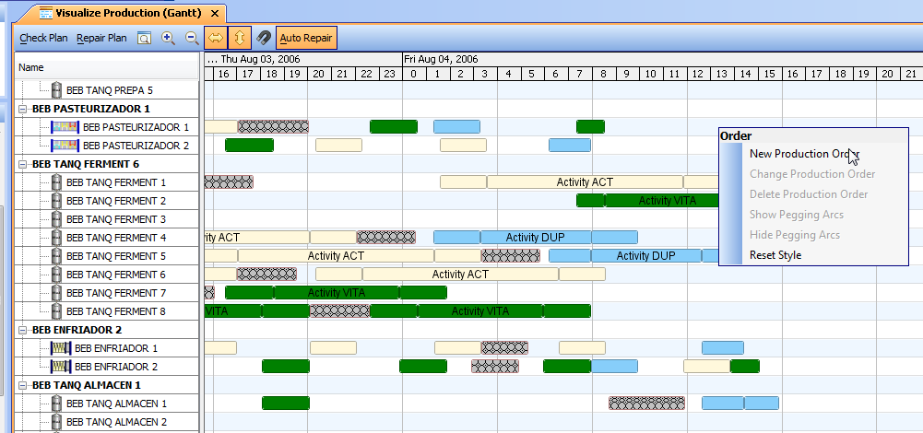
Trigger execution activities based on optimization
Select recipe
Select product & product line
Create order

Slide 25
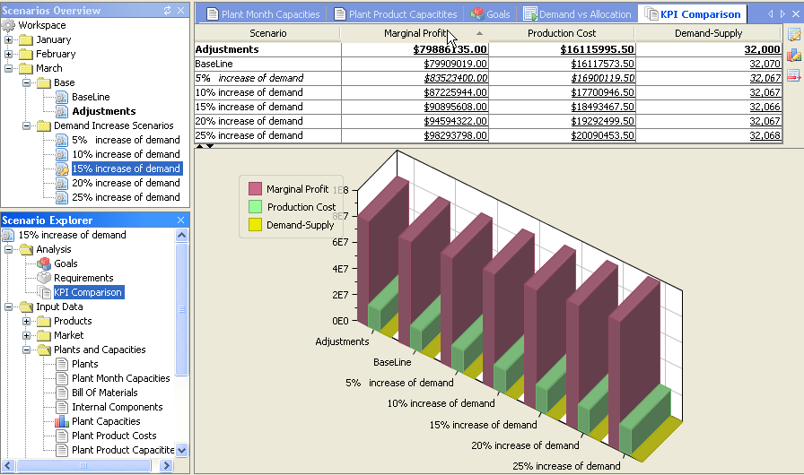
Communicating optimization results to your business
Multi-scenario exploration is key!
Consider multiple input data scenarios (e.g. multiple demand forecasts)
Compare impact of different scenarios on KPIs
Allow end-user to experiment with alternative scenarios

Slide 26
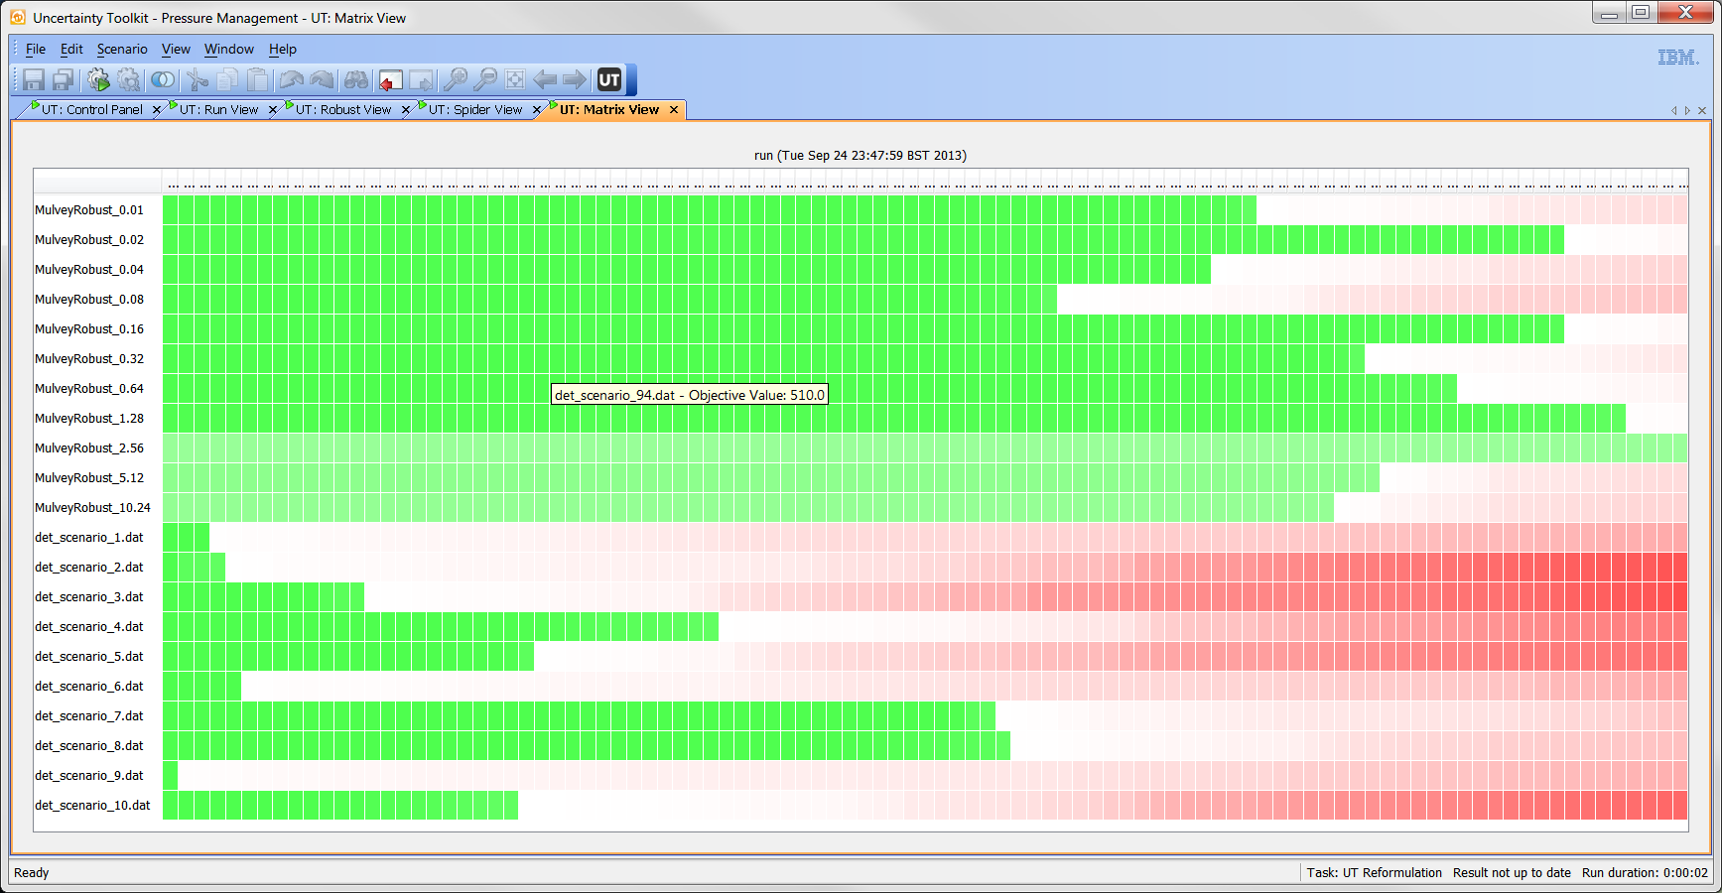
Dealing with data uncertainty
Hedge against uncertainty via “what-if” and robust/stochastic optimization
Brighter green means better KPI performance
Robust optimization yields more stable plans
(more green across scenarios)
y-axis:
plans
Robust plans
Brighter read means worse failure
Deterministic plans
Ignoring uncertainty may lead to “broken” plans
(more red across scenarios)
x-axis: demand scenarios

Slide 27
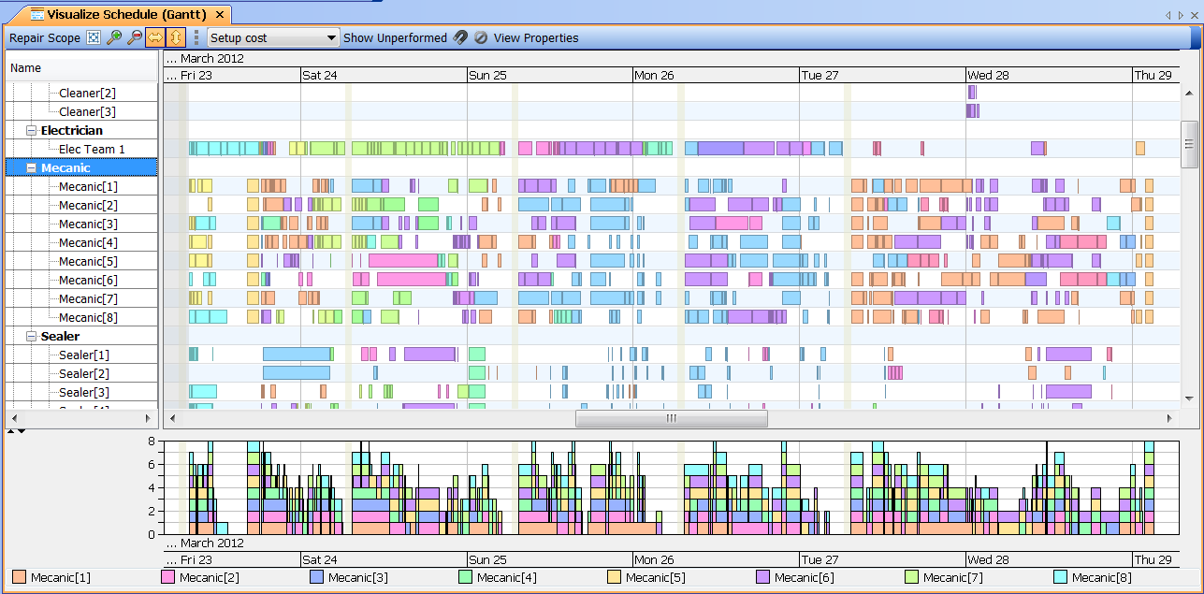
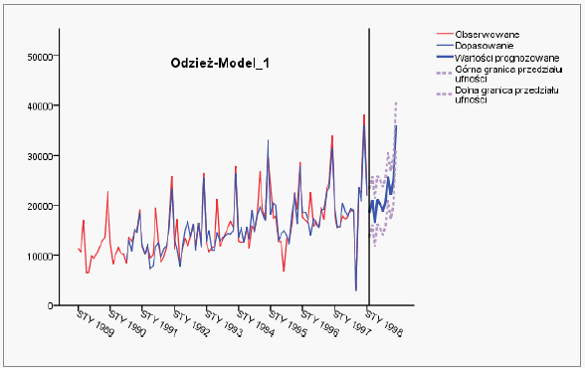
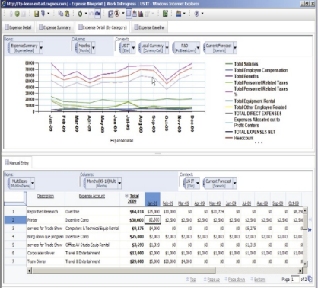
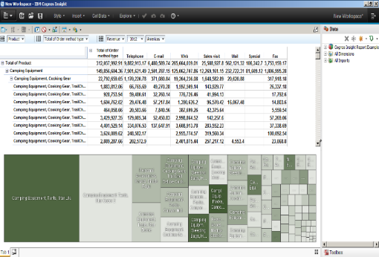
Decision Optimization in end-to-end IBM Analytics Example: Advanced S&OP Lifecycle
Import historical sales transaction data and master data
Determine demand trends, seasonality and key correlations
Let planners review and edit forecast and master data
Allow planners to create multiple what-if scenarios
Automate capacitated plan generation
TM1
Decision Optimization
SPSS
TM1
TM1

Slide 28
Optimization for LoB – typical use cases
Marketing
Sales
Finance
IT
Operations
HR
Descriptive & predictive analytics
Prescriptive analytics (optimization)
ROI
analysis
Campaign
planning
Customer
retention
Territory optimization
Prioritizing
accounts
Receivable
Portfolio optimization
Helpdesk
case
Analysis
Staff assignment
Warranty
analysis
Sales & operations planning
Employee
retention
Compensation & training planning

Slide 29
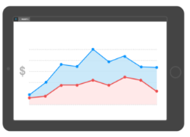
Bridget’s story
What is the revenue breakdown by region?
What are the predicted sales per region?
How should I create territories to maximize quota achievement fairly?
Bridget Hart Sales Manager
Descriptive analytics
Descriptive analytics
Descriptive analytics
Descriptive Analytics
Predictive Analytics
Prescriptive Analytics
Notes:
What does this mean for Bridget?

Slide 30
Bridget’s story
Today’s demo
What is the revenue breakdown by region?
What are the predicted sales per region?
How should I create territories to maximize quota achievement fairly?
Bridget Hart Sales Manager
Descriptive analytics
Descriptive analytics
Descriptive analytics
Descriptive Analytics
Predictive Analytics
Prescriptive Analytics
Notes:
What does this mean for Bridget?

Slide 31
Demo: sales territory optimization use case

Slide 32
How can I leverage IBM Decision Optimization in TM1?
Case study: Dynamic pricing using promotions, markdowns, and clearance strategies

Slide 33
Pricing using promotions, markdowns, and clearance strategies
Notes:
Introduce used case
Discuss plan data
Discuss Actual data and compare
Discuss Data by season
Identify Miss target in specific season apparrel
Introduce skus
Work on each sku with predictive
Work on each sku with optimization –
Dynamic prcing rwa’s idea
Markdown opt / clearance / promotions
Optimize and build scenarios

Slide 34
Retail optimization use case
Vertical: Retail
Products: Apparel & Accessories
Objective: Maximize Revenue, Maximize margin, Reduce Inventory
Decisions: Dynamic Pricing
What do I have: Initial Plan
Status: Review the week
Decisions: Pricing
Dynamic Pricing
Markdowns
Price Points
Clearance
Promotions

Slide 35
How did we do last week? Plan vs. Actual
REVENUE TARGET
ACTUAL Revenue

Slide 36
How did we do last week? Plan vs. Actual
We missed both in
sales revenue,
units sold and
margin
REVENUE TARGET
ACTUAL Revenue

Slide 37
How did we do last week? Plan vs. Actual
Which season/s was the problem?
REVENUE TARGET
ACTUAL Revenue

Slide 38
Where did we miss?
SPRING 2016 is the problem!
We missed on Revenue and on units

Slide 39
What can we do?
Using TM1 we can analyze the data and identify Variance in the Plan vs. Actual
How can we affect the demand?
Promotions
Markdowns
Clearance
How do we decide which products, groups, when to act?

Slide 40
Technology
We use Predictive analytics
To predict the sales for next week/s
To identify slow and fast moving products
To identify products that react well in markdowns and promotions
We use Prescriptive analytics – optimization
To decide optimal prices that maximize our revenue
To decide when to offer promotions to maximize our revenue

Slide 41
What are the data we need for each SKU?
Average Price
$16.07
Total Sold * Price
IS NOT EQUAL to REVENUES SO FAR
Avg. Sales through
3.14%

Slide 42
What is the output of the optimization?
SKU ID | Price | Cost | Days on the Floor | Total Quantity Ordered | Revenue | Cost of Sold | Current Margin | Total Sold Units | Total Length of Selling period | Liquidation price
SKU999 | $24.04 | $6.85 | 77 days | 1794 | $9969 | $4247 | 57.4% | 620 | 24 weeks | $6.85
Average Price
$16.07
Avg. Salesthrough
3.14%
PROMOTE 30% NEXT WEEK

Slide 47
Learn more
Product
Slow moving
Fast Moving
Bad Sales Lift
Good Sales Lift
Bad Sales Lift
Good Sales Lift

Slide 48
Notes:
Are all product responding to promotions?
twotypes of very slowing moving products.
Products responding well to promotions(Strong sales lift) and products that don’t respond well (Weak Sales lift)

Slide 50
SLOW MOVING PRODUCT

Slide 51
Summary
Use IBM Decision Optimization to
Optimize trade-offs when faced with conflicting goals and constrained resources
Gain competitive advantage!
DO is available standalone and can be used together with most IBM solutions (including TM1)
Where to find us at Vision:
Twitter: @IBMoptimization
E-mail:
Susara van den Heever (Program Manager, IBM Decision Optimization): svdheever@fr.ibm.com
Yianni Gamvros (WW Technical Sales Lead, IBM Decision Optimization): yianni.gamvros@us.ibm.com
Alkis Vazacopoulos (CEO, Optimization Direct): alkis@optimizationdirect.com
Come talk to us at the IBM Decision Optimization demo ped
to see how optimization can help your business

Slide 52
Please Note:
IBM’s statements regarding its plans, directions, and intent are subject to change or withdrawal without notice at IBM’s sole discretion.
Information regarding potential future products is intended to outline our general product direction and it should not be relied on in making a purchasing decision.
The information mentioned regarding potential future products is not a commitment, promise, or legal obligation to deliver any material, code or functionality. Information about potential future products may not be incorporated into any contract.
The development, release, and timing of any future features or functionality described for our products remains at our sole discretion.
Performance is based on measurements and projections using standard IBM benchmarks in a controlled environment. The actual throughput or performance that any user will experience will vary depending upon many factors, including considerations such as the amount of multiprogramming in the user’s job stream, the I/O configuration, the storage configuration, and the workload processed. Therefore, no assurance can be given that an individual user will achieve results similar to those stated here.

Slide 53
Acknowledgments, disclaimers and trademarks
© Copyright IBM Corporation 2015/2016. All rights reserved.
The information contained in this publication is provided for informational purposes only. While efforts were made to verify the completeness and accuracy of the information contained in this publication, it is provided AS IS without warranty of any kind, express or implied. In addition, this information is based on IBM’s current product plans and strategy, which are subject to change by IBM without notice. IBM shall not be responsible for any damages arising out of the use of, or otherwise related to, this publication or any other materials. Nothing contained in this publication is intended to, nor shall have the effect of, creating any warranties or representations from IBM or its suppliers or licensors, or altering the terms and conditions of the applicable license agreement governing the use of IBM software.
References in this publication to IBM products, programs or services do not imply that they will be made available in all countries in which IBM operates. Product release dates and/or capabilities referenced in this presentation may change at any time at IBM’s sole discretion based on market opportunities or other factors, and are not intended to be a commitment to future product or feature availability in any way. Nothing contained in these materials is intended to, nor shall have the effect of, stating or implying that any activities undertaken by you will result in any specific sales, revenue growth, savings or other results. All statements regarding IBM future direction and intent are subject to change or withdrawal without notice, and represent goals and objectives only.
Information concerning non-IBM products and services was obtained from a supplier of those products and services. IBM has not tested these products or services and cannot confirm the accuracy of performance, compatibility, or any other claims related to non-IBM products and services. Questions on the capabilities of non-IBM products and services should be addressed to the supplier of those products and services.
All customer examples cited or described are presented as illustrations of the manner in which some customers have used IBM products and the results they may have achieved. Actual environmental costs and performance characteristics may vary by customer and will vary depending on individual customer configurations and conditions. Nothing contained in these materials is intended to, nor shall have the effect of, stating or implying that any activities undertaken by you will result in any specific sales, revenue growth or other results.
Prices are suggested U.S. list prices and are subject to change without notice. Starting price may not include a hard drive, operating system or other features. Contact your IBM representative or Business Partner for the most current pricing in your geography.
IBM, the IBM logo, ibm.com, and other IBM products and services are trademarks or registered trademarks of International Business Machines Corporation in the United States, other countries, or both. If these and other IBM trademarked terms are marked on their first occurrence in this information with a trademark symbol (® or ™), these symbols indicate U.S. registered or common law trademarks owned by IBM at the time this information was published. Such trademarks may also be registered or common law trademarks in other countries. A current list of IBM trademarks is available on the Web at "Copyright and trademark information" at ibm.com/legal/copytrade.shtml

Slide 54
Notices and Disclaimers
Copyright © 2016 by International Business Machines Corporation (IBM). No part of this document may be reproduced or transmitted in any form without written permission from IBM.
U.S. Government Users Restricted Rights - Use, duplication or disclosure restricted by GSA ADP Schedule Contract with IBM.
Information in these presentations (including information relating to products that have not yet been announced by IBM) has been reviewed for accuracy as of the date of initial publication and could include unintentional technical or typographical errors. IBM shall have no responsibility to update this information. THIS DOCUMENT IS DISTRIBUTED "AS IS" WITHOUT ANY WARRANTY, EITHER EXPRESS OR IMPLIED. IN NO EVENT SHALL IBM BE LIABLE FOR ANY DAMAGE ARISING FROM THE USE OF THIS INFORMATION, INCLUDING BUT NOT LIMITED TO, LOSS OF DATA, BUSINESS INTERRUPTION, LOSS OF PROFIT OR LOSS OF OPPORTUNITY. IBM products and services are warranted according to the terms and conditions of the agreements under which they are provided.
Any statements regarding IBM's future direction, intent or product plans are subject to change or withdrawal without notice.
Performance data contained herein was generally obtained in a controlled, isolated environments. Customer examples are presented as illustrations of how those customers have used IBM products and the results they may have achieved. Actual performance, cost, savings or other results in other operating environments may vary.
References in this document to IBM products, programs, or services does not imply that IBM intends to make such products, programs or services available in all countries in which IBM operates or does business.
Workshops, sessions and associated materials may have been prepared by independent session speakers, and do not necessarily reflect the views of IBM. All materials and discussions are provided for informational purposes only, and are neither intended to, nor shall constitute legal or other guidance or advice to any individual participant or their specific situation.
It is the customer’s responsibility to insure its own compliance with legal requirements and to obtain advice of competent legal counsel as to the identification and interpretation of any relevant laws and regulatory requirements that may affect the customer’s business and any actions the customer may need to take to comply with such laws. IBM does not provide legal advice or represent or warrant that its services or products will ensure that the customer is in compliance with any law

Slide 55
Notices and Disclaimers Con’t.
Information concerning non-IBM products was obtained from the suppliers of those products, their published announcements or other publicly available sources. IBM has not tested those products in connection with this publication and cannot confirm the accuracy of performance, compatibility or any other claims related to non-IBM products. Questions on the capabilities of non-IBM products should be addressed to the suppliers of those products. IBM does not warrant the quality of any third-party products, or the ability of any such third-party products to interoperate with IBM’s products. IBM EXPRESSLY DISCLAIMS ALL WARRANTIES, EXPRESSED OR IMPLIED, INCLUDING BUT NOT LIMITED TO, THE IMPLIED WARRANTIES OF MERCHANTABILITY AND FITNESS FOR A PARTICULAR PURPOSE.
The provision of the information contained h erein is not intended to, and does not, grant any right or license under any IBM patents, copyrights, trademarks or other intellectual property right.
IBM, the IBM logo, ibm.com, Aspera®, Bluemix, Blueworks Live, CICS, Clearcase, Cognos®, DOORS®, Emptoris®, Enterprise Document Management System™, FASP®, FileNet®, Global Business Services ®, Global Technology Services ®, IBM ExperienceOne™, IBM SmartCloud®, IBM Social Business®, Information on Demand, ILOG, Maximo®, MQIntegrator®, MQSeries®, Netcool®, OMEGAMON, OpenPower, PureAnalytics™, PureApplication®, pureCluster™, PureCoverage®, PureData®, PureExperience®, PureFlex®, pureQuery®, pureScale®, PureSystems®, QRadar®, Rational®, Rhapsody®, Smarter Commerce®, SoDA, SPSS, Sterling Commerce®, StoredIQ, Tealeaf®, Tivoli®, Trusteer®, Unica®, urban{code}®, Watson, WebSphere®, Worklight®, X-Force® and System z® Z/OS, are trademarks of International Business Machines Corporation, registered in many jurisdictions worldwide. Other product and service names might be trademarks of IBM or other companies. A current list of IBM trademarks is available on the Web at "Copyright and trademark information" at: www.ibm.com/legal/copytrade.shtml.

Slide 56
Thank You.
Your Feedback is Important!
Access the Vision 2016 Conference Attendee Portal to complete your session surveys from your smartphone,
laptop or conference kiosk.

