Slide 1
11b. Retail Analytics –
Product Life Cycle Planning

Slide 2
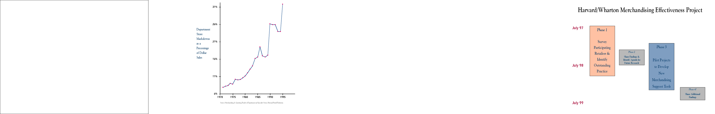
Some interesting observations…
31%
Too many of the wrong products
Department store markdowns as a percentage of sales
26%
21%
16%
11%
6%
1970 1980 1990 1995
“One third of customers entering a store leave without buying because they can’t find what they came for”
Too few of the right products

Slide 3
What’s causing these problems?
Inflexible Supply Chains & Long lead times
Up to 11 months for apparel products sourced from Asia, but some – World and Zara – achieved 2 week lead times
Inaccurate forecasts
50% -100% errors for a season forecast at chain level is typical
Store level execution cannot be assumed
Stock outs caused by inventory record errors or product in the backroom

Slide 4
Some interesting observations…
Too much inventory leads to end-of-season surpluses that must be cleared with margin-killing markdowns
Too little inventory causes stockouts and missed sales
Key elements to balance between margin lost and sales foregone:
  An accurate forecast
  A flexible supply chain
  Appropriate supply of inventory

Slide 5
Retailers have data that can help, but … don’t use it (1)
Scanners and data warehousing has created huge databases, but retailers lack ability to analyze this data
“We are awash in data and starved for information”
History -> seasonality, price elasticity, store/SKU patterns, size mix, reaction to promotion, etc.
“How can history possibly be useful in a fashion business?”

Slide 6
Retailers have data that can help, but … don’t use it (2)
Inadequate tools - Planning paradigms are replenishment of staples and ‘one and done’ category planning for fashion products
Reality is many products like shoes, home fabrics, books & music, toys, etc. have features of staples and fashion – limited life but can replenish & items matter
Need to manage at the SKU store level
But can’t do this without analytic tools – too much data for a manual approach

Slide 7
The payoff from fixing this can be huge
  Data + analytic tools
  = better in-stock + fewer mark-downs
  =profit increase of 5 – 10% of revenue
Better analytics can easily double a retailers profit

Slide 8
Retail Operations (current state)
Goal = Max Profit = revenue – variable cost (cost of goods, inventory holding and obsolescence)
Stores
Raw Materials/ Components Sourcing
New Product Development/Selection
Plants
DC
Consumers
Buyer & Designer
Assortment planning
Buyer/Planner
Forecast Demand
Set Inventory levels
Pricing & Promotion
Lead time management e.g. when to use air freight
Store Manager
Execution e.g. product
display, customer service
POS price changes
Accuracy of inventory
data

Slide 9
Retail Operations (the analytics way)
Stores
Raw Materials/ Components Sourcing
New Product Development/Selection
Consumers
Plants
DC
Determine Optimal Inventory, Price and Promotion over time for season
Track Data Accuracy
Estimate Demand Density
Sales & Inventory by SKU/Store
Loyalty Card Information
Data Warehouse for model calibration
-seasonality, price elasticity,
size mix, store differences

Slide 10
Product Life Cycle Planning
Merchandise Test
Ongoing Replenishment / Model Stock Setting
Phase Down / End of Life / Markdown
Read & React Period
Pregnancy
Youth
Middle age
Retirement
Forecast initial demand (prelaunch forecast)
Survey experts
Mall intercepts
Prior products
Merchandise test
Initial buy
Preposition materials
Read early sales, update forecast and reorder as needed
Expedite resupply?
Rollout to more stores or drop stores?
Traditional long life cycle replenishment – set target stock levels for each SKU-store
Update forecast and rebuy as appropriate (lead time is the time needed to receive the rebuy)
Manage down replenishment flow
Drop product in selected stores
Markdown price or transfer to outlet stores
Notes:
One reason planning for short life cycle products is so difficult is that the rate of acceleration through a product’s life is rapid. Each stage, from ‘Merchandise Test’ to ‘Early Read’, then to ‘Replenishment’ and finally to ‘End of Life’ has differing supply-chain parameters. Quite often, a model developed for replenishment doesn’t capture when a product is nearing of life. Also difficult is to create a forecast from a merchandise test and know how to scale that to a chain and then use it to plan early demand. The above graph shows that you are actually trying to solve not one, but four different problems.

Slide 11
Product Life Cycle Planning
The life cycle planning can be split into 3 categories based on the ratio of the length of life to replenishment lead time
  Lead time ≥ life single buy (one-and-done mode) - replenishment is impossible
  Life >> lead time replenishment soon after product launch
  Lead time is little less product life only a few replenishment orders can be made (or you may have a single one-and-done buy and you allocate part of the inventory at the distribution center and stores are replenished from that supply

Slide 12
Improving Accuracy of Product Lunch Forecasts
  Women’s Apparel Catalog
  Product Lunch Forecasting
  Initial Buy Strategies
  Two-buy Strategies (Read and React)
*From Fisher M and Raman A: The New Science of Retailing, HBP, 2010

Slide 13
Fashion Cataloger Example – Initial Buy
Decide how much to buy of each assortment of women’s dresses and other clothing to be offered in a catalog that would last for 26 weeks
  Because of long production lead times, orders are placed several months before
  It is assumed that customers couldn’t backorder an order for a sold out product becomes lost sale
  Any inventory left at the end of catalog’s life, it is sold at a deep discount

Slide 14
“We” beats “Me”: A new way of deliberating
Use a committee of expert to deliberate
Forecast Committee Results
Product | Anna | Laurie | Julie | Kim | Committee Average | Committee Standard Deviation
Navy Turtleck | 89 | 86 | 102 | 102 | 95 | 7
Red Cardigan | 51 | 100 | 152 | 39 | 86 | 45
Blue Vest | 30 | 91 | 183 | 76 | 95 | 56
Remember: Standard Deviation = √Σ(X_{i}-X)²/N

Slide 15
Initial Forecasts: Groping in the Dark
After 26 weeks we know the actual demand
Product | Committee Average | Committee Standard Deviation | Actual Demand | Forecast Error | Absolute Deviation
Navy Turtleck | 95 | 7 | 85 | -10 | 10
Red Cardigan | 86 | 45 | 132 | 47 | 47
Blue Vest | 95 | 56 | 29 | -66 | 66
When the Committee agrees, they tend to be Accurate

Slide 16
Forecast Errors Cost Money
Mean Absolute Deviation (MAD) =50%
Mean Absolute Percentage Error (MAPE) = 55%
MAD=(Total Absolute Deviation)/(Total Actual Demand)
MAPE= Average of Individual Percentage Deviations

Slide 17
Errors tend to be small when committee members agree!
The Committee Process is a powerful way to determine what you can and what you cannot predict
High
Error
Average
Error =
116 units
Average
Error =
645 units
Low
Error
High Agreement
Low Agreement

Slide 18
Forecast Errors Cost Money
What is the cost of forecast errors?
Under-buy Cost = Normal price – Cost = Opportunity Cost
Over-buy Cost = Cost – Markdown price
Product | Cost ($) | Normal Price ($) | Markdown Price ($) | Under-buy Cost ($ per unit) | Over-buy Cost ($ per unit)
Navy Turtleneck | 40 | 60 | 18 | 20 | 22
Red Cardigan | 77 | 160 | 48 | 83 | 29
Blue Vest | 65 | 110 | 33 | 45 | 32

Slide 19
Buying Strategies
Buy the Forecast
Hedge: Buy the forecast + 10%
Probabilistic risk adjusted hedge
Risk adjust using a continuous Gamma Distribution

Slide 20
Buying Strategy: Buy the forecast
Product | Buy Q'ty | Actual Demand | Sales | Gross margin on Sales | Markdown units | Loss on markdowns | Net Profit | Lost sales | Lost Margin
Navy Turtleck | 95 | 85 | 85 | 1,700 | 10 | 220 | 1,480 | 0 | 0
Red Cardigan | 86 | 132 | 86 | 7,138 | 0 | 0 | 7,138 | 46 | 3,818
Blue Vest | 95 | 29 | 29 | 1,305 | 66 | 2,112 | -807 | 0 | 0
Totals | 276 | 246 | 200 | 10,143 | 76 | 2,332 | 7,811 | 46 | 3,818

Slide 21
Buying Strategy: Buy the forecast + 10%
Product | Buy Q'ty | Actual Demand | Sales | Gross margin on Sales | Markdown units | Loss on markdowns | Net Profit | Lost sales | Lost Margin
Navy Turtleck | 105 | 85 | 85 | 1,700 | 20 | 440 | 1,260 | 0 | 0
Red Cardigan | 95 | 132 | 95 | 7,885 | 0 | 0 | 7,885 | 37 | 3,071
Blue Vest | 105 | 29 | 29 | 1,305 | 76 | 2,432 | -1,127 | 0 | 0
Totals | 305 | 246 | 209 | 10,890 | 96 | 2,872 | 8,018 | 37 | 3,071

Slide 22
Buying Strategy: Probabilistic Risk-Adjusted Hedge
Estimate the probability of different possible outcomes, and then follow a strategy that works best on average
For example, assume that the 4 catalog buyers have equal probability to be right, 25% 86 units, 25% 89 units, 25% 102 units and 25% 102 units.
Calculate the expected probability-weight cost for different buying quantities, and choose the one that does best on average.

Slide 23
Buying Strategy: Probabilistic Risk-Adjusted Hedge
For example, assume that the buying quantity Q is 94 for the navy turtleneck.
  If demand is 86, you over-buy 8 units at a cost of $176 (8*22)
  If demand is 89, you over-buy 5 units at a cost of $110
  If demand is 102, you under-buy 8 units at a cost of $160 (8*20)
  The overall expected cost EC(Q=94) in this case is EC = 0.25*176 + 0.25*110 +0.50*160 = 151.50

Slide 24
Probabilistic Risk-Adjusted Hedge
Probability | 0.25 |  | 0.25 |  | 0.5
Demand Scenaria | Demand = 86 |  | Demand = 89 |  | Demand = 102 |  | Total Expected Cost
Buy Qty (Q) | Lost Margin | Mark-down Cost | Lost Margin | Mark-down Cost | Lost Margin | Mark-down Cost
80 | 120 | 0 | 180 | 0 | 440 | 0 | 295.0
81 | 100 | 0 | 160 | 0 | 420 | 0 | 275.0
82 | 80 | 0 | 140 | 0 | 400 | 0 | 255.0
83 | 60 | 0 | 120 | 0 | 380 | 0 | 235.0
84 | 40 | 0 | 100 | 0 | 360 | 0 | 215.0
85 | 20 | 0 | 80 | 0 | 340 | 0 | 195.0
86 | 0 | 0 | 60 | 0 | 320 | 0 | 175.0
87 | 0 | 22 | 40 | 0 | 300 | 0 | 165.5
88 | 0 | 44 | 20 | 0 | 280 | 0 | 156.0
89 | 0 | 66 | 0 | 0 | 260 | 0 | 146.5
90 | 0 | 88 | 0 | 22 | 240 | 0 | 147.5
91 | 0 | 110 | 0 | 44 | 220 | 0 | 148.5
92 | 0 | 132 | 0 | 66 | 200 | 0 | 149.5
93 | 0 | 154 | 0 | 88 | 180 | 0 | 150.5
94 | 0 | 176 | 0 | 110 | 160 | 0 | 151.5
To calculate EC for Q = 80, condition on the demand:
EC=0.25*120+0.25*180+0.5*440
= 295.0
NOTE: for every Buying Q’ty Q, the cost might be either Lost Margin (if Q<D) or Markdown (if Q>D)
NOTE: Expected Cost keeps going down as we increase Q, up to Q=89. For Q>89, EC starts increasing
Therefore, Q* = 89

Slide 25
Apply same approach to all products
Probabilistic risk adjusted hedge
Product | Buy Q'ty | Actual Demand | Sales | Gross margin on Sales | Markdown units | Loss on markdowns | Net Profit | Lost sales | Lost Margin
Navy Turtleck | 89 | 85 | 85 | 1,700 | 4 | 88 | 1,612 | 0 | 0
Red Cardigan | 100 | 132 | 100 | 8,300 | 0 | 0 | 8,300 | 32 | 2,656
Blue Vest | 91 | 29 | 29 | 1,305 | 62 | 1,984 | -679 | 0 | 0
Totals | 280 | 246 | 214 | 11,305 | 66 | 2,072 | 9,233 | 32 | 2,656

Slide 26
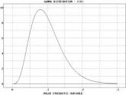
Buying Strategy: Risk-Adjusted using GAMMA Distribution
Conceptually the same as the previous strategy, but you evaluate all possible demand scenarios
Normal distribution not appropriate because it gives negative values of demand
The Gamma distribution can be bell-shaped, or can be skewed

Slide 27
Probability values for demand of navy turtleneck using Gamma
Demand | Probability | Cumulative Probability | Demand | Probability | Cumulative Probability
70 | 0.000 | 0.000 | 96 | 0.053 | 0.604
71 | 0.000 | 0.000 | 97 | 0.051 | 0.655
72 | 0.000 | 0.000 | 98 | 0.048 | 0.703
73 | 0.001 | 0.001 | 99 | 0.044 | 0.747
74 | 0.001 | 0.002 | 100 | 0.04 | 0.787
75 | 0.001 | 0.003 | 101 | 0.036 | 0.823
76 | 0.002 | 0.005 | 102 | 0.032 | 0.855
77 | 0.002 | 0.007 | 103 | 0.028 | 0.883
78 | 0.003 | 0.010 | 104 | 0.023 | 0.906
79 | 0.005 | 0.015 | 105 | 0.02 | 0.926
80 | 0.007 | 0.022 | 106 | 0.016 | 0.942
81 | 0.009 | 0.031 | 107 | 0.013 | 0.955
82 | 0.012 | 0.043 | 108 | 0.011 | 0.966
83 | 0.015 | 0.058 | 109 | 0.008 | 0.974
84 | 0.019 | 0.077 | 110 | 0.007 | 0.981
85 | 0.023 | 0.100 | 111 | 0.005 | 0.986
86 | 0.028 | 0.128 | 112 | 0.004 | 0.990
87 | 0.033 | 0.161 | 113 | 0.003 | 0.993
88 | 0.038 | 0.199 | 114 | 0.002 | 0.995
89 | 0.042 | 0.241 | 115 | 0.002 | 0.997
90 | 0.046 | 0.287 | 116 | 0.001 | 0.998
91 | 0.049 | 0.336 | 117 | 0.001 | 0.999
92 | 0.052 | 0.388 | 118 | 0.001 | 1.000
93 | 0.054 | 0.442 | 119 | 0 | 1.000
94 | 0.055 | 0.497 | 120 | 0 | 1.000
95 | 0.054 | 0.551 | 121 | 0 | 1.000

Slide 28
Evaluating an ordering policy
Suppose you want to evaluate ordering Q=95
If D=70, have 25 units leftover, so cost = 25*22=$550
If D=21, have 24 units leftover, so cost = 24*22=$528
…..
If D=95, have no leftover units, and no lost sales
…
If D=110, have no leftover units, but have 15 units lost sales, so cost = 15*20=$300
…
EC(Q=95) = Sum of all the above costs, multiplied by the probability it occurs
Repeat for all values of Q until determine Q*

Slide 29
Another way to calculate Q*
Use marginal profitability approach (newsboy problem)
Suppose you have bought 93 units, and you are considering to buy a 94th
If it sells, you make $20 profit
If it doesn’t, you loose $22 in markdown
P(it will sell) = P(D>93) = 1-P(D≤93) = 1-0.442=0.558
P(it will not sell) = P(D≤93) = 0.442
E(net profit)=$20*0.558 – $22*0.442 = $1.44 … OK
For a 95th: E(net profit)=$20*.503-$22*.497= -0.87 … NO!

Slide 30
General way to calculate Q*
Assume p=marginal unit sells (from table)
Find a quantity to buy so that expected profit on marginal unit is positive, but turns negative when you buy one more
(unit profit from selling)*p – (unit from not selling)*(1-p)=0
Where p=cumulative probability of D at the specific unit
(normal price-cost)*p-(cost-markdown Price)*(1-p) = 0
And therefore
p* = (cost-markdown price)/(normal price – markdown price)
Look at tables of Gamma for the unit number Q* whose p* is above

Slide 31
Using Excel for the GAMMA distribution
Can get the values of Gamma from Excel: GAMMADIST function
Initially, the numeric probabilities for each product are calculated assuming a gamma distribution with mean and standard deviation to be the committee’ average and standard deviation, respectively.
Excel GAMMADIST(d, a, b, true / false)
  a= (average/standard deviation)^2
  b= (standard deviation)^2/average
  True -> cumulative distribution / False -> Probability

Slide 32
Fashion Cataloger Example – Initial Buy
Step1. An appropriate (scenario) demand range is selected for each product
Step 2. You calculate the GAMMA distribution parameters a and b
Step 3. Using Excel GAMMADIST(demand,a,b,true) you calculate the cumulative distribution p_{i} (the probability that the demand will be less than or equal to demand i) for all demand values i within the above range
Step 4. You calculate the probability/chance of selling (1-p_{i}) the i+1 unit (probability that demand exceeds i)

Slide 33
Fashion Cataloger Example – Initial Buy
Step 5. You calculate the probability p* that the marginal unit sells but the next one doesn’t:
  p*=(cost-markdown price)/(normal price – markdown price))
Step 6. You determine the optimal buy quantity
  Look at the tables for the closest p ≤ p*, then your optimal quantity to buy is the corresponding value of demand.

Slide 34
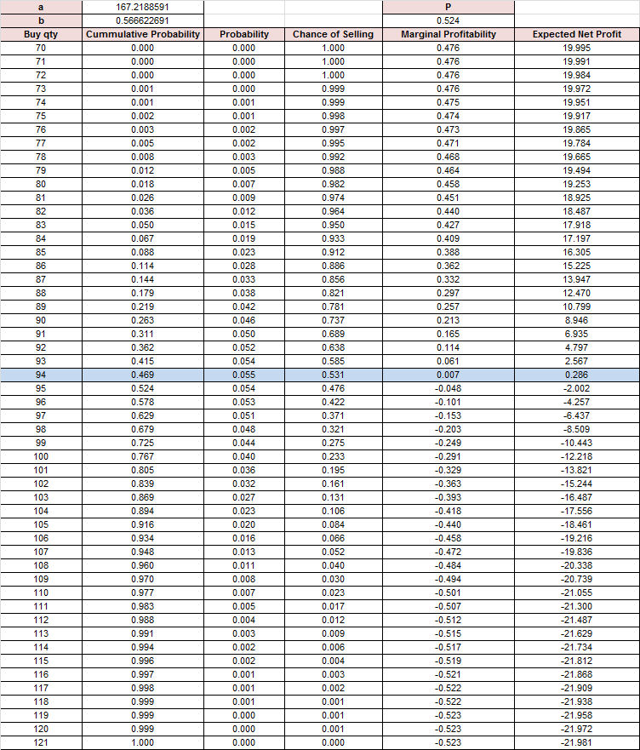

Slide 35
Buying Strategy: Risk-Adjusted using GAMMA Distribution
Product | Buy Q'ty | Actual Demand | Sales | Gross margin on Sales | Markdown units | Loss on markdowns | Net Profit | Lost sales | Lost Margin
Navy Turtleck | 94 | 85 | 85 | 1,700 | 9 | 198 | 1,502 | 0 | 0
Red Cardigan | 109 | 132 | 109 | 9,047 | 0 | 0 | 9,047 | 23 | 1,909
Blue Vest | 96 | 29 | 29 | 1,305 | 67 | 2,144 | -839 | 0 | 0
Totals | 299 | 246 | 223 | 12,052 | 76 | 2,342 | 9,710 | 23 | 1,909

Slide 36
Fashion Cataloger Example – Use Early Sales to Improve Accuracy
Early sales are highly predictive and can be used to improve the forecast
Method: Update the forecast during the season by extrapolating early sales based on what fraction of the total we estimate they constitute
  Condition: We need to know the % of sales rates per period
    Past catalogs and previous sales cycles can be used to estimate the sales rates per period

Slide 37
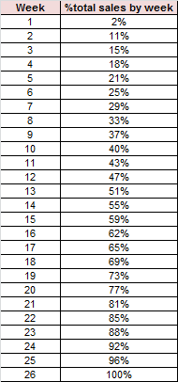
Fashion Cataloger Example – Use Early Sales to Improve Accuracy
Distribution of sales per week
For example, suppose that an item sold 11 units at week 2, then the forecast at week 26 will be 100 units (11 sales represented 11% of total season sales)

Slide 38
Fashion Cataloger Example – Use Early Sales to Improve Accuracy
Expert Forecast by a Committee of Four Merchandisers
Forecast Obtained by Extrapolating the First 2 Weeks (11%) of Orders
Average Forecast Error is 55%
Average Forecast Error is 8%

Slide 39
Fashion Cataloger Example – Two Buy Strategies / Read and React
If the lead time allows mid-season replenishments, how much you should initially buy?
Strategy: “Buy a little, sell a little, update your forecast and buy more if needed”
  It should be enough so you won’t sell out in the initial period, but not so much that you will you have excess inventory and you have to dump at a loss at the end of season.

Slide 40
Reading and reacting to early sales
100.0
This portion of demand can be supplied based on an accurate forecast.
90.0
% of Total
80.0
Season
70.0
Sales
60.0
Achieved
50.0
40.0
30.0
20.0
10.0
0.0%
Lead Time
Week of season
Initial Shipment to Cover Read/ React Period +
Safety Stock Based on Error Margin in the Forecast
Replenishment
Supply
Read Market
& Order More of Hot Sellers

Slide 41
Fashion Cataloger Example – Two Buy Strategies / Read and React
Initial Buy
Replenishment
Order Placed
Replenishment Order Arrives
End of Life
Initial Demand
Life cycle Demand
Probability
Initial Demand
The Initial Buy should minimize the cost of both stockouts and closeouts
Closeout R
Initial Buy Quantity
Notes:
The chart above depicts the process we use for an initial buy. We first estimate the probability of various demand levels over two periods – the period that the initial buy needs to cover until the first resupply arrives and a period equal to the life of the product. We then choose the initial buy to minimize the total expected cost of two risks – stocking out during the initial demand period and losing sales and margin, and buying more than life cycle demand resulting in product left over at the end of life that has to be marked down and sold at a loss.
The goal is to balance the risk of buying too much and risking obsolescence or buying too little and risking a stockout. The “sweet spot” is purchasing the optimal amount that maximizes gross margin.

Slide 42
Fashion Cataloger Example – Two Buy Strategies / Read and React
Step 1. Estimate the probability of various demand levels over two periods:
  the period that the initial buy needs to cover until the first resupply arrives, and
  the period equal to the life of the product
Step 2. Choose the initial buy to minimize the total expected cost of two risks – stocking out during the initial demand period, and buying more than life cycle demand.
The “sweet spot” is purchasing the optimal amount that maximizes gross margin.

Slide 43
Fashion Cataloger Example – Two Buy Strategies / Read and React
Scenario: We can reorder at the end of week 2 based on the improved early season forecast, and the additional product would arrive at the end of week 14, with 12 weeks left to sell it.

Slide 44
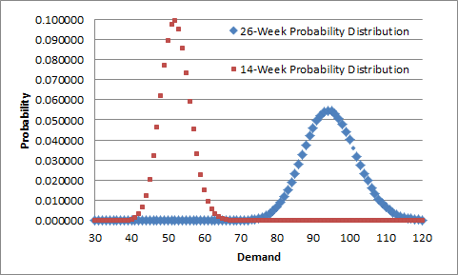
Fashion Cataloger Example – Two Buy Strategies / Read and React
Probabilities for 14-week and 26-week periods for the Navy Turtleneck

Slide 45
Fashion Cataloger Example – Two Buy Strategies / Read and React
The optimal buying quantity for the 14-week period is 69:
  Net Profitability:
  Underbuy Cost*(1 - 14-Week Cumulative Probability) –
  - Overbuy Cost*26-Week Cumulative Probability
  Demand 69 net profitability is 0.000062
  Demand 70 net profitability is -0.001828 (not justified)
  The same analysis shows that the optimal buying quantities for the red cardigan and the blue vest are 71 and 68

Slide 46
Fashion Cataloger Example – Two Buy Strategies / Read and React
Once sales begin, the forecast is updated and a second buy is made (if needed).
How big should be the second buy?
Blue vest: You don’t want to buy more!
Navy Turtleneck: Buy the 26-week season forecast minus the initial buy quantity
Red Cardigan: Buy the 26-week season forecast minus the initial buy quantity minus the lost sales

Slide 47
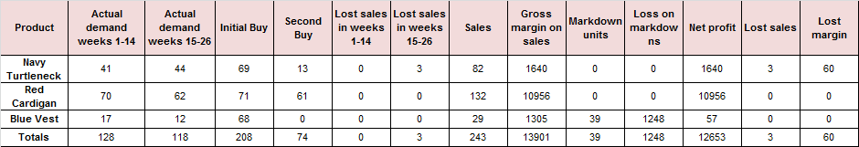
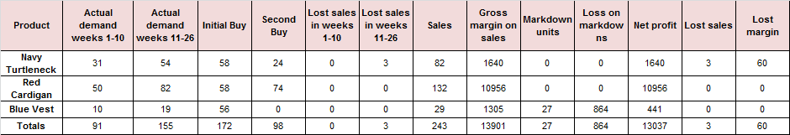
Fashion Cataloger Example – Two Buy Strategies / Read and React
Lead time 12 weeks
Lead time 8 weeks (102$ more on faster transportation mode)

Slide 48
Fashion Cataloger Example – Two Buy Strategies / Read and React
Putting all together for all items of the catalog
18%
15%
Incremental $ Gross Margin as a % of Base Case Revenue
10%
Benefits of Read React
7.5%
3.5%
0
3
6
9
12
Base Case
Lead Time (Weeks)

Slide 49
Improving Accuracy of Product Lunch Forecasts
  Shoe Retailer
  Forecasting with Predictive Modeling

Slide 50
Shoe Retailer Example – Updating the forecast using Predictive Modeling
Objective To improve demand forecast using early sales data and decide mid-season replenishment order quantities
Jan
Feb
March
April
May
June
Initial Supply
in Stores
Replenishment
Orders
Order Arrivals

Slide 51
Shoe Retailer Example – Updating the forecast using Predictive Modeling
Simple Extrapolation of Early Sales Didn’t Work!

Slide 52
Shoe Retailer Example – Updating the forecast using Predictive Modeling
Because price markdowns and stockouts were affecting sales

Slide 53
Shoe Retailer Example – Updating the forecast using Predictive Modeling
Forecast of sales of SKU j in week t
Estimate of season sales based on early sales
Seasonality factor estimated from history
Price factors
Inventory Factor

Slide 54
Shoe Retailer Example – Updating the forecast using Predictive Modeling
sales forecast for style j in period t
Base forecast for style j
Seasonality factor, the historical % of total season sales we expect to occur in week t
Average ration of price to cost for all styles in week t
Price cost ratio for style j in week t
Minimum average inventory needed to prevent lost sales (e.g. 10 pairs per store)
Inventory of style j in all stores in week t

Slide 55
Shoe Retailer Example – Updating the forecast using Predictive Modeling
Forecast of sales of SKU j in week t
Estimate of season sales based on early sales
Seasonality factor estimated from history
Price factors
Inventory Factor

Slide 56
Shoe Retailer Example – Updating the forecast using Predictive Modeling
More accurate forecasts by taking price and inventory into account (forecast error of 16%)

Slide 57
Shoe Retailer Example – Updating the forecast using Predictive Modeling
Weekly forecast vs actual for one sandal

Slide 58
Shoe Retailer Example – Updating the forecast using Predictive Modeling
Application of this approach to one style-color
 | Original plan | Optimized forecast | Actual results
Unit Receipts | 6,210 | 14,160 | 12,325
Unit sales | 9,882 | 14,875 | 14,579
Gross Margin $ | $385,497 | $580,274 | $562,269

