Slide 1
06-462
OPTIMIZATION MODELING AND ALGORITHMS
Chrysanthos E. Gounaris
Department of Chemical Engineering
Carnegie Mellon University
gounaris@cmu.edu
Lecture 04: Thursday, January 23, 2014

Slide 2
WHAT IS GAMS?
The General Algebraic Modeling System is a high-level modeling language used to express optimization formulations
www.gams.com
Advantages:
Admits all problem types (LP, IP, NLP, MILP, MINLP)
Interfaces with a variety of solvers
Can express models compactly and symbolically
Data and models are stored separately
Disadvantages:
Overhead slows execution
Cumbersome to do scientific computations for preparing input data or for post-processing optimization results

Slide 3
WHY PREFER GAMS?
Optimization models can be solved also in popular environments such as Excel, Mathematica, Matlab, Maple, etc.
However, GAMS is superior when it comes to large-scale models
GAMS does not implement solvers, rather than it interfaces with the best freely- or commercially-available ones
You can easily try various applicable solvers and find what works best for your problem
The other environments typically have proprietary routines, which may not necessarily be state-of-the-art nor “the best” for a given problem

Slide 4
HOW DOES GAMS WORK?
The user creates a text file in GAMS-readable format (a Windows editor interface is available)
This file is saved with the extension .gms and can be provided as input to the GAMS software
GAMS compiles and executes, providing
output to console
output to file(s), as instructed by the user
a default file with extension .lst providing record of the run, including optimal solution values and any possible compilation or runtime errors

Slide 5
WHERE IS GAMS?
Computer Lab
Access via VPN
Download a free demo version for your personal computer: http://www.gams.com/download/
All functions are available
No time expiration
Has limits on model size, but should be sufficient for homework assignment

Slide 6
MODELING IN GAMS
MODELS

Slide 7
MODELING IN GAMS
$$\min_{x}{f(x)}$$
$$s.t. g\left(x\right)≤0$$
$$x∈X$$
$$\min_{x,z}{z}$$
$$s.t. z=f(x)$$
$$g\left(x\right)≤0$$
MODELS
$$x∈X$$
$$z∈ℝ$$

Slide 8
COMMENTS
Any line starting with * constitutes a comment and is not interpreted by the GAMS parser
GAMS code
* This is a comment
GAMS code
End of line commenting is also possible via the following declaration:
$eolcom ##
GAMS code ## This is a comment

Slide 9
COMMENTS
Larger blocks of the file can become comments as follows
$ontext
everything here are comments
…..
$offtext

Slide 10
SETS
Sets are representative of indices in the vectors or matrices used in the problem formulation
Syntax:
Set set_name comments / element_1, element_2, … , element_n /;

Slide 11
SETS
Examples:
Set MATH_COURSES courses available / DiffEq, Prob, LinAlg /;
Set COLORS the set of colors / Yellow, Green, Blue, Orange, Red /;

Slide 12
SETS
Often useful to abbreviate the elements of a set:
Set i tasks / i1, i2, i3, i4, i5, i6, i7, i8 /;
When you have a successive number of elements like above can further reduce to:
Set i tasks / i1*i8 /;
(GAMS will expand this as above)

Slide 13
DATA
Essential to any problem is the data
Different types of data types are defined based on the dimensionality they are commonly used for:
Parameter and Table are in fact generic keywords (can be used with any dimensionality)
Data Type | Dimension
Scalar | 0
Parameter | 1
Table | 2

Slide 14
SCALARS
A scalar is a fixed parameter (a constant), and has no association with any set
Syntax:
Scalar scalar_name comments / scalar_value /;
Examples:
Scalar Pi the value of “pi” / 3.14159265 /;
Scalar Life financial lifetime of productive units / 20 /;
Scalar Balance amount of money in my bank account as of 11/10 /18530/;

Slide 15
PARAMETERS
A parameter defines a vector and is associated with a set
Syntax:
Parameter parameter_name(set_name) comments / element_1 value_1, element_2 value_2, … , element_n value_n /;
Example:
Set DOGS dogs in race / dog1*dog5 /;
Parameter ODDS(DOGS) probability of dogs winning / dog1 0.20, dog2 0.25, dog3 0.00, dog4 0.30, dog5 0.25 /;
This unlucky dog can be omitted !

Slide 16
TABLES
A parameter defines a matrix and is associated with two sets
Syntax for an n by m table:
Table table_name(setA_name, setB_name) comments
;
 | element_B_1 | element_B_2 | . . . | element_B_m
element_A_1 | value_1_1 | value_1_2 | . . . | value_1_m
element_A_2 | value_2_1 | value_2_2 | . . . | Value_2_m
. . . | . . . | . . . |  | . . .
element_A_n | value_n_1 | value_n_2 | . . . | value_n_m
Don’t forget the semicolon !

Slide 17
TABLES
Example:
Set DOGS dogs in race / dog1*dog5 /;
Set RACES races being run / race1*race3 /;
Table ODDS(DOGS, RACES) probability of dogs winning each race
;
 | race1 | race2 | race3
dog1 | 0.20 | 0.10 | 0.30
dog2 | 0.25 | 0.08 | 0.19
dog3 | 0.00 | 0.12 | 0.20
dog4 | 0.30 | 0.40 | 0.30
dog5 | 0.25 | 0.30 | 0.01

Slide 18
DATA
Declaration, definition of data can occur separately
Redefinition of data is also possible
If no definition is provided, the value of 0.0 is given by default
Example:
Scalar a /50/;
Scalar b; b = 50; b = 60;
Set i /i1*i3/;
Parameter c(i); c(‘i1’) = 1; c(‘i2’) = 2; c(‘i3’) = 3;

Slide 19
VARIABLES
Variables can be declared either as scalars (0-dimensional) or over sets (multi-dimensional)
Syntax:
variable_type Variable variable_name comments ;
variable_type Variable variable_name(set_name) comments ;
Declared type | Type | Values allowed
Free | Continuous | -inf to +inf
Positive | Continuous | 0.0 to +inf
Negative | Continuous | -inf to 0.0
Binary | Discrete | 0, 1
Integer | Discrete | Any integer

Slide 20
VARIABLES
Examples:
Free Variable z objective function ;
Set i some index / i1, i2, i3 /;
Positive Variable x(i) problem variables ;
$$\min_{x,z}{z}$$
$$s.t. z=f(x)$$
$$g\left(x\right)≤0$$
$$x∈X$$
$$z∈ℝ$$

Slide 21
VARIABLES
Each variable is a collection of 4 attributes
Attribute | Access Symbol | Before solution | After solution
Level | .l | User can initialize solver | Solver reports optimal solution
Lower bound | .lo | User can set lower bound | No change (solver does not use this)
Upper bound | .up | User can set upper bound | No change (solver does not use this)
Margin | .m | No use | Solver may report solution sensitivity

Slide 22
VARIABLES
Once declared, user may change these attributes
Example:
Positive Variable x some variable ;
x.lo = 5; x.up = 10;
Set i some set /i1*i5/;
Positive Variable y(i) some other variables ;
y.lo(i) = 5; y.up(i) = 10;
y.lo(‘i3’) = 4; y.up(‘i3’) = 12;
y.lo(‘i5’) = 2; y.up(‘i5’) = 2; ## also, y.fx(‘i5’) = 2;

Slide 23
EQUATIONS
Equations make use of declared data and variables to symbolically define the formulation’s constraints (including the “z = obj. function” constraint)
Syntax (declaration):
Equation equation_name comments ;
Equation equation_name(set_name) comments ;
Equation equation_name(setA_name, setB_name) comments ;

Slide 24
EQUATIONS
Syntax (definition):
equation_name.. G(var, data) =L= 0 ;
equation_name.. G(var, data) =E= 0 ;
equation_name.. G(var, data) =G= 0 ;
equation_name(set_name).. G(var, data, set_name) =L= 0 ;
equation_name(setA_name, setB_name)..
G(var, data, setA_name, setB_name) =L= 0 ;
where G is a function using GAMS function notation (see manual)

Slide 25
EQUATIONS
Examples:
Equation objf ;
objf.. z =E= sum(i, p(i) * x(i));
Equation sumbound;
sumbound.. sum(i, x(i)) =L= card(i);
Equation constraint(i);
constraint(i).. q(i) * power(x(i), 2) =G= beta + gamma;

Slide 26
MODELS
Once all relevant equations have been defined, they can be bundled into a model object (multiple models may exist in a single file)
Syntax:
Model model_name comments / all / ;
Model model_name comments / objf, sumbound, constraint / ;
All defined elements of the array “constraint”

Slide 27
CALLING THE SOLVER!
A model can now be passed to an applicable solver
Only solvers applicable for the particular model type (LP, NLP, MIP, MINLP) may be selected
Multiple solvers may be applicable, so we need to select the one we want
Syntax:
Option model_type = solver_name;
Solve model_name using model_type minimizing objV_name;

Slide 28
CALLING THE SOLVER!
Examples:
Option LP = CPLEX;
Solve mymodel1 using LP minimizing z1;
Option NLP = CONOPT;
Solve mymodel2 using NLP maximizing z2;
Option MINLP = BARON;
Solve mymodel3 using MINLP minimizing z3;

Slide 29
DISPLAYING THE RESULTS
Solver progress and final result will be displayed in console, but exact output will depend on which solver was used
Optimization results will certainly be included in the .lst file, though may be hard to find
Better provide a command to neatly display optimization results. At the end of .gms file, add the following:
Display variable_name.l;

Slide 30
BELIEVING THE RESULTS
After the Solve statement is executed, the model and solver return status numbers which are stored in the model object
model_name.modelstat
model_name.solvestat
These numbers describe important properties of the model and solver such as feasibility or guarantees of optimality of the solution
They are given in the listing file generated after one attempts to solve a model (or can be conveniently displayed via display)
What each number means can be found in the GAMS manual

Slide 31
A TOY EXAMPLE (TRANSPORTATION PROBLEM)
*
*transportation costs are assumed to be $90 per case per kMile

Slide 32
OPEN GAMS

Slide 33
CREATE A PROJECT

Slide 34
CREATE .GMS FILE
SETS
Plants
Markets
SCALARS (0-D)
Unit cost per kMile
PARAMETERS (1-D)
Plant capacities
Market demands
TABLES (2-D)
Plant-to-market distances
Cost per case
(= unit cost * distance)

Slide 35
CREATE .GMS FILE
SETS
Plants
Markets
SCALARS (0-D)
Unit cost per kMile
PARAMETERS (1-D)
Plant capacities
Market demands
TABLES (2-D)
Plant-to-market distances
Cost per case
(= unit cost * distance)

Slide 36
CREATE .GMS FILE
VARIABLES
Quantities (2-D, positive)
Obj. function value (0-D, free)
EQUATIONS
Objective definition (0-D)
Don’t exceed plant capacities (1-D)
Do meet market demands (1-D)
MODEL
All equations defined thus far
CALL SOLVER
Use LP solver
DISPLAY OUTPUT
$x^{∗}$ and $z^{∗}$ to be displayed in .lst file

Slide 37
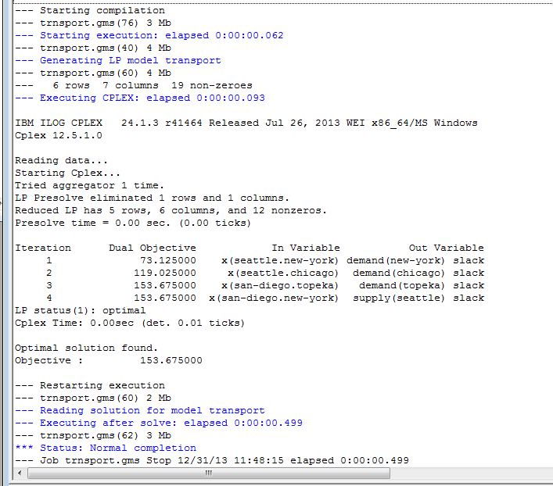
RUN GAMS

Slide 38
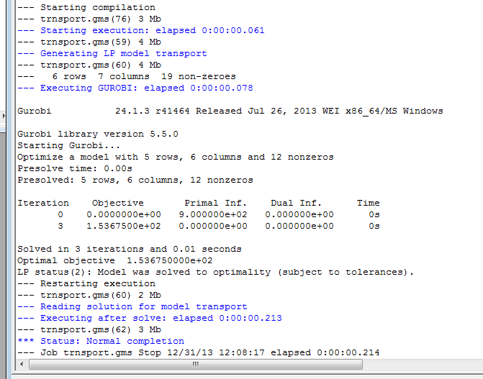
RUN GAMS

Slide 39
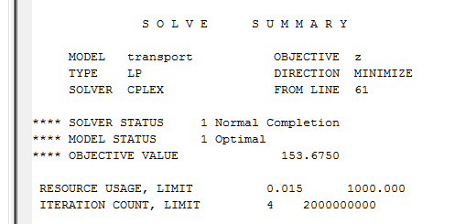
RUN GAMS

Slide 40
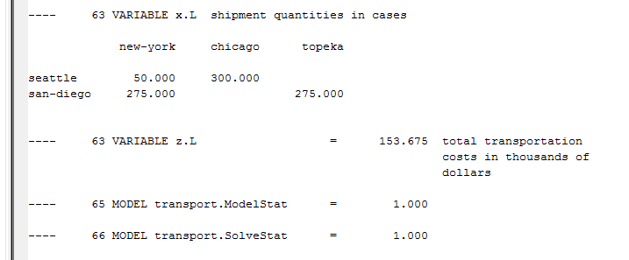
RUN GAMS

Slide 41
ONLINE REFERENCES
GAMS Model Library http://www.gams.com/modlib/modlib.htm
GAMS – A User's Guide http://www.gams.com/dd/docs/bigdocs/GAMSUsersGuide.pdf
GAMS List Archive (Archived Answers to Most Frequently Asked Questions) http://www.gams.com/maillist/gams-l-archive.pdf

Slide 42
06-462
OPTIMIZATION MODELING AND ALGORITHMS
Chrysanthos E. Gounaris
Department of Chemical Engineering
Carnegie Mellon University
gounaris@cmu.edu
Lecture 05: Tuesday, January 28, 2014

Slide 43
MODELING IN GAMS
MODELS

Slide 44
MODELING IN GAMS
$$\min_{x}{f(x)}$$
$$s.t. g\left(x\right)≤0$$
$$x∈X$$
$$\min_{x,z}{z}$$
$$s.t. z=f(x)$$
$$g\left(x\right)≤0$$
MODELS
$$x∈X$$
$$z∈ℝ$$

Slide 45
SETS
Often useful to abbreviate the elements of a set:
Set i tasks / i1, i2, i3, i4, i5, i6, i7, i8 /;
When you have a successive number of elements like above can further reduce to:
Set i tasks / i1*i8 /;
(GAMS will expand this as above)

Slide 46
SET OPERATORS
The elements of each set are ordered
The operator ord() returns the relative position of a member in a set (ord() starts with 1)
Example:
Set t “this decade” / Y2011*Y2020 /;
Parameter r(t); ## r(‘Y2011’) = 1; r(‘Y2012’) = 2; … r(‘Y2020’) = 10;
r(t) = ord(t);
Remember that set elements are strings and have no numerical value, so need to use ord() to convert a set element to a number

Slide 47
SET OPERATORS
The operator card() returns the cardinality of the set (i.e., the number of its elements)
Linear Lead/Lag Operators (+, -)
Parameters a(t), b(t) ;
a(t) = 3 + ord(t) ;
b(t) = a(t-1) ;
Circular Lead/Lag Operators (++, --) wrap around the end of the set
Parameters c(s), d(s) ;
c(s) = ord(s) ;
d(s) = c(s++2) ;
a(t) = { 4, 5, 6, 7, 8, 9 }
b(t) = { 0, 4, 5, 6, 7, 8 }
c(s) = { 1, 2, 3, 4, 5, 6 }
d(s) = { 3, 4, 5, 6, 1, 2 }

Slide 48
LOOPS
Looping along the elements can be done with Loop
Loop(set_name,
## some valid code here that references set_name
);
Example:
Set i / i1, i2, i3, i4 / ;
Parameter a(i);
Loop(i,
a(i) = 2*ord(i);
);
a(i) = { 0, 0, 0, 0 }
a(i) = { 2, 4, 6, 8 }

Slide 49
CONDITIONAL LOOPS
Looping is more meaningful when it needs to be performed across only a subset of the set’s elements
Loop(set_name$(condition),
## some valid code here that references set_name
);
Example:
Set i / i1, i2, i3, i4 / ;
Parameter a(i);
Loop(i$(ord(i) <= 2),
a(i) = 2*ord(i);
);
a(i) = { 0, 0, 0, 0 }
a(i) = { 2, 4, 0, 0 }

Slide 50
PROGRAM FLOW CONTROL
The While statement
While(condition,
## some valid code here that might make condition become false
);
Example:
Set i / i1, i2, i3, i4 / ;
Parameter a(i);
a(i) = 2*ord(i);
While$(a(‘i4’) < 25,
a(i) = a(i) + a(i-1);
);
a(i) = { 2, 4, 6, 8 }
a(i) = { 2, 6, 12, 20 }
a(i) = { 2, 8, 20, 40 }

Slide 51
PROGRAM FLOW CONTROL
The If-Elseif-Else statement
If(condition,
## statements here
Elseif(condition),
## statements here
Else
## statements here
);
Example:
Loop(i$(ord(i) <= 10),
If(ord(i) <= 2,
a(i) = 1;
Elseif(ord(i) <= 4),
a(i) = 4;
Elseif(ord(i) <= 6),
a(i) = b(i);
Else
a(i) = -1;
);
);
a(i) = { 1, 1, 4, 4, b(‘i5’), b(‘i6’), -1, -1, -1, -1, ?, ?, … }

Slide 52
PROGRAM FLOW CONTROL
The For statement
Scalar counter;
For(counter = start to end by incr,
## statements here referencing counter
);
Example:
Scalar cnt; Parameter a(i);
For(cnt = 3 to 10 by 2,
a(i)$(ord(i) = cnt) = 1;
);
Loop(i$(ord(i) = cnt), a(i) = 1);
a(i) = { 0, 0, 1, 0, 1, 0, 1, 0, 1, 0, 0, 0, 0, … }

Slide 53
PROGRAM FLOW CONTROL
There are restrictions on what you can do inside a Loop, While, If-Elseif-Else, or For statement
You may not declare sets, parameters, variables, etc.
You may not define equations
However, you may run a Solve statement (presumably by updating the model based on the controlling index)
while(s > 0,
scalar y ; y = 5 ;
);
NO!!
while (s > 0,
eq.. sum(i,x(i)) =G= 2 ;
);
NO!!

Slide 54
EQUATIONS
Equation objf ;
objf.. z =E= sum(i, p(i) * x(i));
Equation sumbound;
sumbound.. sum(i, x(i)) =L= card(i);
Equation constraint(i);
constraint(i).. q(i) * power(x(i), 2) =G= beta + gamma;

Slide 55
EQUATIONS
Equation constraint(i);
constraint(i).. q(i) * power(x(i), 2) =G= beta + gamma;
Declared for all elements of i
Defined for all elements of i
Although you have to declare for all i, there is no need to define it for all i

Slide 56
EQUATIONS
Equation constraint(i);
constraint(i)$(ord(i) > 10 and q(i) < 2.34).. q(i) * power(x(i), 2) =G= beta + gamma;
Declared for all elements of i
Defined for all elements of i
Although you have to declare for all i, there is no need to define it for all i

Slide 57
EQUATIONS
Frequent example:
Equation constraint(i);
constraint(i)$(ord(i) > 1).. x(i) =G= y(i-1);
constraint(i)$(ord(i) = 1).. x(i) =G= y0;

Slide 58
EQUATIONS
Frequent example:
Equation constraint(i);
constraint(i)$(ord(i) > 1).. x(i) =G= y(i-1);
Equation constraint_bound;
constraint_bound.. x(‘i1’) =G= y0;
Model mymodel /constraint, constraint_bound/;
Although all constraints added in the list, the model will only
include those constraints that were actually defined

Slide 59
ALIASES
Sometimes it is convenient to define aliases for a particular set
For example, consider the need to declare the constraints
The following is erroneous
Set i / i1, i2, i3, i4 /;
Constraint(i) .. x(i) – sum(i, y(i)) =E= 0;
$$x_{i}−\sum_{i^{′}}{y_{i^{′}}}=0 ∀ i$$

Slide 60
ALIASES
Sometimes it is convenient to define aliases for a particular set
For example, consider the need to declare the constraints
One way to do this would be
Set i / i1, i2, i3, i4 /;
Set ip / i1, i2, i3, i4 /;
Constraint(i) .. x(i) – sum(ip, y(ip)) =E= 0;
But this is cumbersome and prone to mistakes
$$x_{i}−\sum_{i^{′}}{y_{i^{′}}}=0 ∀ i$$

Slide 61
ALIASES
Sometimes it is convenient to define aliases for a particular set
For example, consider the need to declare the constraints
An alias statement introduces additional name(s) for the set
Set i / i1, i2, i3, i4 /;
alias(i, ip);
Constraint(i) .. x(i) – sum(ip, y(ip)) =E= 0;
$$x_{i}−\sum_{i^{′}}{y_{i^{′}}}=0 ∀ i$$

Slide 62
PUT WRITING FACILITY
Output to console and to the listing file are mostly predetermined (user has very little control via some options)
GAMS offers the ability for the user to create customized output to some external text file
A number of put statements can be used to that purpose

Slide 63
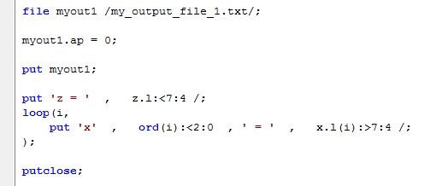
PUT WRITING FACILITY

Slide 64
PREPROCESSOR
Preprocessor directives affect the parsing of the file and take effect before compilation
$setglobal symbol value
For everything below this line, a text replacement of the string “symbol” with the string “value” occurs
$include “filename”
Interjects in this spot the text from a separate file (path relevant to where the .gms file is)
$eolcom symbol
Below this line “symbol” signifies the start of an inline comment

Slide 65
OPTIONS
There are certain keywords for common solver options
Option optcr = tolerance;
Select relative tolerance for global NLP, MIP, MINLP runs (default of 10% is generally too high!)
Option optca = tolerance;
Select absolute tolerance for global NLP, MIP, MINLP runs
Option LP = LPsolver_name;
Select solver for LP (see Solver manual for what is available); Similarly for NLP, MIP, MINLP

Slide 66
ONLINE REFERENCES
GAMS Model Library http://www.gams.com/modlib/modlib.htm
GAMS – A User's Guide http://www.gams.com/dd/docs/bigdocs/GAMSUsersGuide.pdf
GAMS List Archive (Archived Answers to Most Frequently Asked Questions) http://www.gams.com/maillist/gams-l-archive.pdf

