Slide 1
1.
Why Supply Chain Analytics?
Course Overview
BIA 674 - Supply Chain Analytics

Slide 2
WHY do we need a course on Supply Chain Analytics???

Slide 3
Case 1: Distributors Selection
A WHOLESALER enters a new country and is interested to sell his products in 4 REGIONS
There are 4 available WAREHOUSES, but he needs to select only 2 (out of 4) to work with
Annual costs of each W serving each R (in ‘000$):
Problem: How to choose the best 2 W’s among the 4 ?

Slide 4
A Common Sense Approach Step 1: Assume all warehouses open
The assignment is obvious:
Assign each Region to the Warehouse with the minimum cost!
Total Cost = 110 + 65 + 125 + 100 = 400

Slide 5
Step 2: Close a Warehouse
Close the ONE that would create the least additional cost
A → cost increase = [450 - 110] = 340
B → cost increase = [115 - 65] = 50
C → cost increase = [165 - 125] = 40
D → cost increase = [115 - 100] = 15 !
⇒ Close D & assign R4 to C !
New
Assignment ⇒

Slide 6
Step 3: Close a 2nd Warehouse
Since we have to close one more W, proceed similarly:
Among the remaining W’s (A, B, C) eliminate one:
A → Cost Increase = [640 - 110] = 530
B → Cost Increase = [585 - 65] = 520
C → Cost Increase = [165 - 120] + [580 - 115] = 505 !
⇒ close C !

Slide 7
Final Assignment
Total Cost:
110 + 65 + 165 + 580 = 920
Is this the best?
NO!
The best would be to use A, for regions R1/R3, and D for regions R2/R4
Total cost = 490 (less than half!)

Slide 8
Case 2: Supply Chain Optimization
PLANTS
WAREHOUSES
STORES
S1
3
50,000
P1
0
W1
4
5
5
S2
100,000
4
2
1
P2
W2
60.000
2
2
S3
50,000
Unit transportation costs along each path
Given demands at each store, & capacity constraint of P2
Could include unit production and storage costs, etc

Slide 9
Question
Design the optimal Supply Chain
to min total annual cost !
Need to answer questions like:
Who produces what?
Where is it shipped?
What do the warehouses receive?
From which plant?
What do the stores / outlets receive?
From which warehouse?
When?

Slide 10
Common Sense Method: Step 1
Step 1: Since demand at the Stores has to be satisfied and has to come through the Warehouses, find the Warehouse to best serve each Store
Select least cost path for each S:
Store S1 is best served by Warehouse W2
Store S2 is best served by Warehouse W2
Store S3 is best served by Warehouse W2
S1
S1
W1
4
W1
3
5
S2
S2
2
W2
W2
1
S3
2
S3

Slide 11
Common Sense Method: Step 2
Step 2: Compute demands created at each W/H
Outflows (units): Cost ($)
50,000 units from W2 → S1 ⇒ 100,000
100,000 units from W2 → S2 ⇒ 100,000
50,000 units from W2 → S3 ⇒ 100,000
200,000 300,000
Total transport cost for 2nd half of the chain = $300,000

Slide 12
Common Sense Method: Step 3
Step 3: Determine inflows (200 units to W2) with min cost! (HOWEVER, remember capacity constraint)
Inflows (units): Cost ($)
60,000 units from P2 → W2: ⇒ 120,000
140,000 units from P1 → W2: ⇒ 700,000
820,000
P1
W1
5
P2
2
W2
60.000
TOTAL Annual Cost: 300,000 + 820,000 = $1,150,000 !

Slide 13
Looks like a satisfactory solution
Every store is assigned to the warehouse on its least-cost path.
 Every warehouse uses its least cost plant (up to the full available capacity).
Is this the best solution?
NOOOOO !
BEST = $740,000 !!!

Slide 14
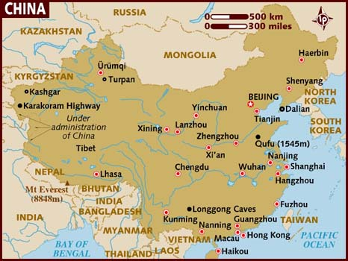
What if we had a larger scale problem?

Slide 15
A Supply Chain in China
Imagine having a similar, but slightly more complex problem. Your company operates a supply chain that includes 5 suppliers of raw materials, 5 manufacturing plants, and 5 cities where your products are sold.
Kashgar
Turban
Lhasa
Kumming
X’ian
Shenyang
Lanzhou
Zhengzhou
Chengdu
Guangzhou
Beijing
Harbin
Shanghai
Hong Kong
Xining
Suppliers
Factories
Stores
Of course, a supply chain in China will be much bigger, and … much more complex!

Slide 16
A Supply Chain in China
Suppliers
Factories
Stores

Slide 17
A Supply Chain in China
Suppliers
Factories
Stores

Slide 18
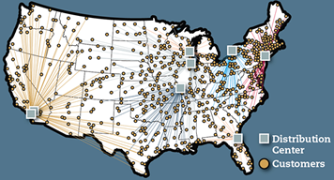
General Network Design Questions (e.g. Walmart)
How many Walmart stores are needed?
Where are locations of those stores?
What are the capacity allocations?
What markets does each store serve?
Which supply sources should be feed into each store?

Slide 19
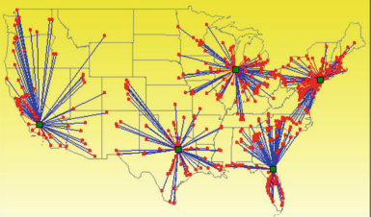
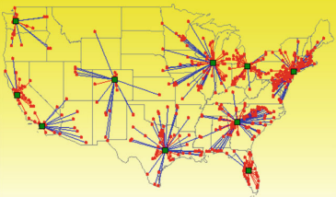
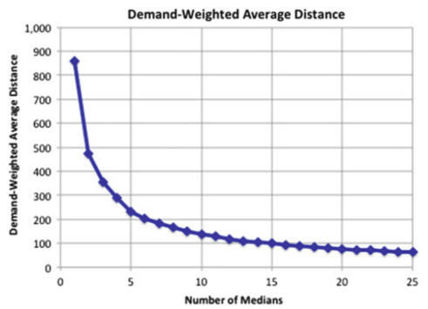
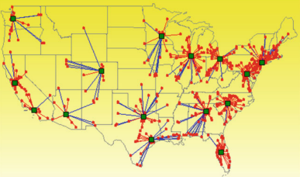
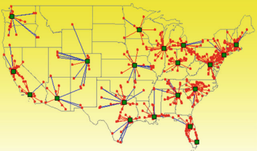
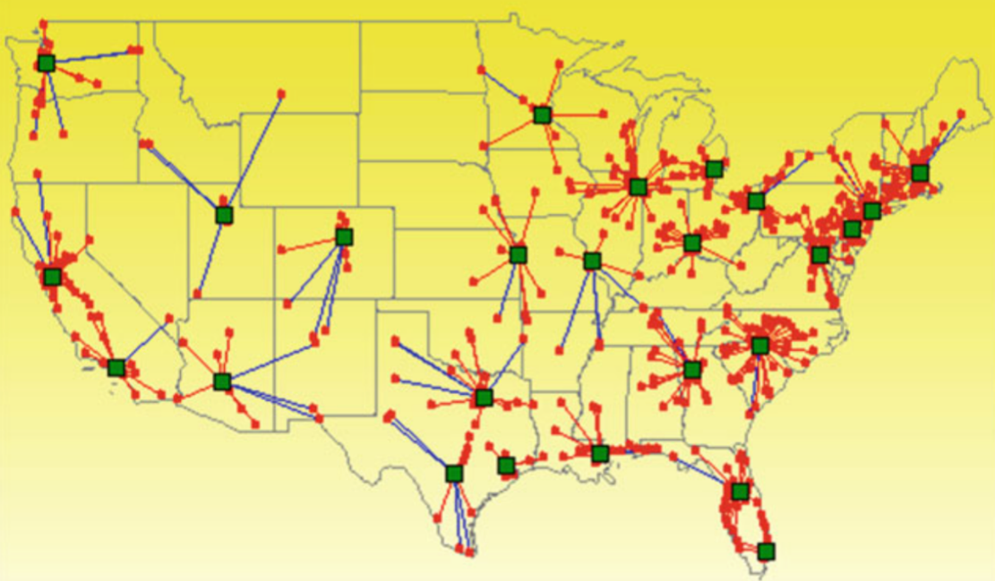
p-Median example
Daskin and Lee Maass (2015), Springer

Slide 20
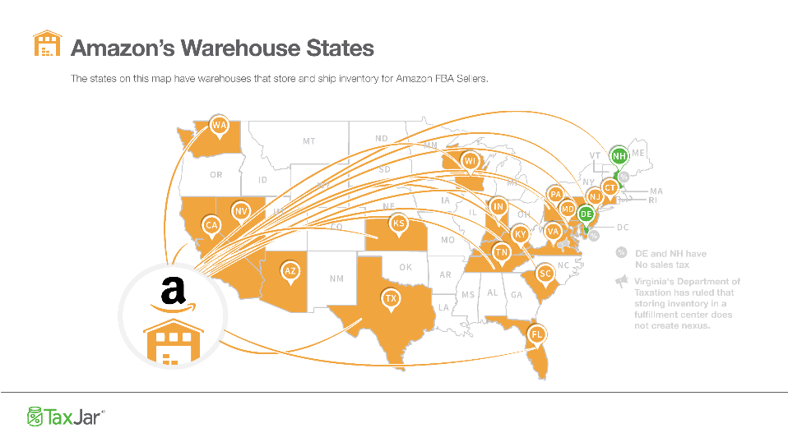
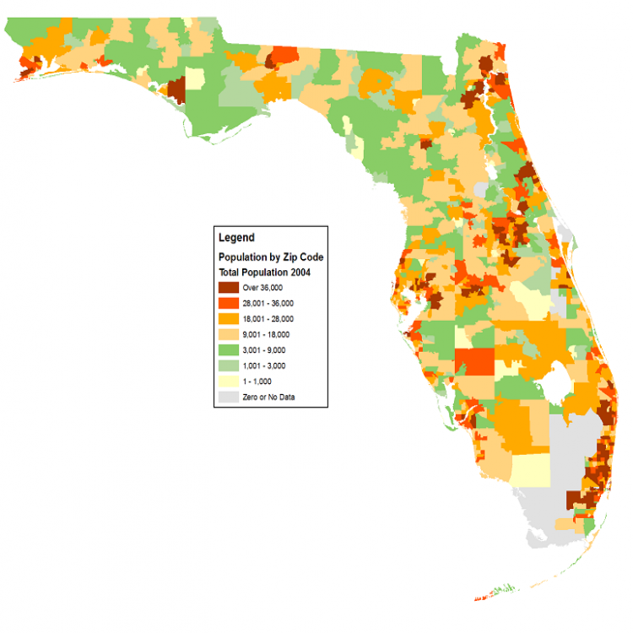

Slide 21
Case 3: Inventory Management
You start working in a company, where demand for a product is at a steady rate of d = 100 tons/month
Purchase price α = $250/ton
Delivery costs k = $50 (each time)
Storage (+ insurance, ...) costs β = $4/ton/month
You look at the inventory behavior of last year, which is as follows:
Inventory Level
• • •
Time
t
Is there anything wrong with this management ?

Slide 22
What is wrong with this management ?
Irrational Ordering (time, quantity) ... why?
Safety stock ... why?
Q
t
T
2T

Slide 23
Case 4: Capacity decision
Company introducing a new product in an international market is evaluating 2 alternatives concerning the initial investment:
Big Plant (cost = $3M)
Small Plant now (cost = $1.4M), with possibility of expansion 2 yrs later (cost = $2.5M)
Demand in the first 2 years could be High (H) or Low (L) with probabilities 70% and 30%

Slide 24
After the initial 2 years
Demand for the product (if initially High) could drop to Low, with probability 15% due to a number of reasons
Competitors enter the market
The product goes out of fashion
The technology becomes outdated

Slide 25
Anticipated Annual Revenues (NPV)
DURING THE FIRST 2 YEARS:
AFTERWARDS:

Slide 26
The Decision Tree
H (85%)
100, 100, 100, 100, ...
4
H (70%)
100, 100, 10, 10, ...
L (15%)
2
L (30%)
10, 10, 10, 10, ...
35, 35, 60, 60, ... 35, 35, 5, 5, ...
35, 35, 25, 25, ...
35, 35, 30, 30, ...
30, 30, 30, 30, ...
B
(-300)
H (85%)
6
E
(-220)
L (15%)
1
5
S
(-100)
H (85%)
7
H(70%)
(0)
3
L (15%)
L (30%)

Slide 27
Looking at the Decision Tree again
Revenues
- Costs
= NET
H (85%)
1.000
- 300
= 700
4
L (15%)
280
- 300
= -20
H (70%)
B
(-300)
L (30%)
100
- 300
= -200
2
E
(-220)
H (85%)
6
550
1
5
L (15%)
110
H(70%)
S
(-100)
(0)
270
- 100
= 170
3
H (85%)
7
310
- 100
= 210
L (15%)
L (30%)
300
- 100
= 200

Slide 28
Can we predict customer reactions or the demand for a product (ice cream)?
Case 5: Demand Forecasting
Day | Temperature | Flyer | Sales
1 | 63 | ✓ | 152
2 | 70 |  | 168
3 | 73 |  | 180
4 | 75 | ✓ | 235
5 | 80 |  | 236
6 | 82 |  | 225
7 | 85 |  | 268
8 | 88 | ✓ | 330
9 | 90 |  | 314
10 | 91 |  | 306
11 | 92 | ✓ | 374
12 | 75 |  | 192
13 | 98 |  | 340
14 | 100 | ✓ | 388
15 | 92 |  | 317
16 | 87 |  | 283
17 | 84 |  | 258
18 | 88 | ✓ | 310
19 | 80 |  | 226
20 | 82 |  | 214
21 | 76 |  | 198
: Flyer was included in the local daily newspaper

Slide 29
Demand Forecasting
Extrapolate past demand data into the future using time-series forecasting methods:
Select a preferred forecasting method from a set of techniques
Quantify the forecasting errors to be experienced when forecasting the future
Use regression analysis to build predictive models that will relate targeted customer segments with casual variable such as price, inventory, and so on.

Slide 30
Time-Series Techniques
Best -> Forecast DES: MAPE 8.177

Slide 31
Do you see any relationships in these data?
Day | Temperature | Flyer | Sales
1 | 63 | 0 | 152
2 | 70 | 0 | 168
3 | 73 | 0 | 180
4 | 75 | 1 | 235
5 | 80 | 0 | 236
6 | 82 | 0 | 225
7 | 85 | 0 | 268
8 | 88 | 1 | 330
9 | 90 | 0 | 314
10 | 91 | 0 | 306
11 | 92 | 1 | 374
12 | 75 | 0 | 192
13 | 98 | 0 | 340
14 | 100 | 1 | 388
15 | 92 | 0 | 317
16 | 87 | 0 | 283
17 | 84 | 0 | 258
18 | 88 | 1 | 310
19 | 80 | 0 | 226
20 | 82 | 0 | 214
21 | 76 | 0 | 198
Two parameters possibly affecting sales: temperature and flyer advertisement in the local daily newspaper
Flyer = 0: No flyer included in the local daily newspaper
Flyer = 1: Otherwise

Slide 32
Sales Forecast – Single Regression
Use as predictor variable the temperature, assuming a linear relationship between sales and temperature
Can I use this model to forecast the demand for a day in 2 months from now?
Can I make forecasts outside the above temperature range?
Should I cleanup the historical data (e.g. days with sold outs)?

Slide 33
Sales Forecast - Multiple Regression
Can I increase predictability by considering flyer promotions on particular days?
The relationship with TWO explanatory (predictor) variables can be formalized as follows:
Sales(t) = B₀ + B₁*Temperature(t)+ B₂*Flyer(t)

Slide 34
Sales Forecast - Multiple Regression
Better predictability than
the original regression (R Square was 0.8928)
SUMMARY OUTPUT
Regression Statistics
Multiple R | 0.969768733
R Square | 0.940451395
Adjusted R Square | 0.933834884
Standard Error | 14.95415498
Observations | 21
ANOVA
 | df | SS | MS | F | Significance F
Regression | 2 | 63571.28991 | 31785.64 | 142.1370421 | 9.41552E-12
Residual | 18 | 4025.281521 | 223.6268
Total | 20 | 67596.57143
 | Coefficients | Standard Error | t Stat | P-value | Lower 95% | Upper 95% | Lower 95.0% | Upper 95.0%
Intercept | -250.4242164 | 31.33367525 | -7.99218 | 2.48511E-07 | -316.2538254 | -184.5946075 | -316.2538254 | -184.5946075
Temperature | 6.027360446 | 0.380548578 | 15.83861 | 5.16976E-12 | 5.227857551 | 6.82686334 | 5.227857551 | 6.82686334
Flyer | 3.000080948 | 8.093034548 | 0.370699 | 0.715188186 | -14.00275371 | 20.0029156 | -14.00275371 | 20.0029156
B₀; B₁; B₂

Slide 35
Sales Forecast - Multiple Regression

Slide 36
Case 6: Assortment Planning
Retail’s Assortment -> the set of products carried in a store(s)
Choose among thousand of products a small subset
Shelf space limitations
Purchasing / Investment capital restrictions
Might decide not to carry all products in all stores
Must take into account whether products align with their brand

Slide 37
Assortment Planning Example
A retailer carries 39 out of 69 brand-size-flavor combinations (2 brands X 2 sizes X 17 flavors = 69) at a particular location.
Prices varied slightly; however, an average price can be assumed for single and family sizes per brand
Store-SKU sales over the last 6 months of 2005 are provided:
Source: Fisher & Raman

Slide 38
Assortment Planning Example
 | Single Size |  | Family Size
Price ($) | 1.29 |  | 3.34
Flavor | Brand A | Brand B | Brand A | Brand B | Revenue ($)
1 | 7246 | 3100 | 472 | 456 | 16445.86
2 | 3182 | 1487 | 551 | 385 | 9149.25
3 | 1398 | 1355 |  | 331 | 4656.91
4 | 353 | 570 |  | 335 | 2309.57
5 | 3100 | 1471 |  | 398 | 7225.91
6 | 1513 | 1155 |  | 184 | 4056.28
7 | 2034 |  | 185 | 139 | 3706.02
8 | 2926 | 563 | 274 |  | 5415.97
9 | 3009 |  | 325 |  | 4967.11
10 | 4780 |  | 380 |  | 7435.4
11 | 2169 | 967 |  |  | 4045.44
12 |  | 224 |  | 60 | 489.36
13 |  | 1596 |  |  | 2058.84
14 |  | 2162 |  |  | 2788.98
15 | 4049 |  |  |  | 5223.21
16 | 1827 |  |  |  | 2356.83
17 |  |  | 100 |  | 334
Totals | 37586 | 14650 | 2287 | 2288 | 82664.94
Sale Shares | 66 | 26 | 4 | 4

Slide 39
Assortment Planning Example
How to find the optimal assortment?
Trial-and-error (guessing) approach:
Iteratively identify poor performing SKUs (e.g. the worst selling) and delete them from the assortment, while add randomly new potential offerings.
Over time you have good chances to identify a productive assortment

Slide 40
Assortment Planning Example
 | Single Size |  | Family Size
Price ($) | 1.29 |  | 3.34
Flavor | Brand A | Brand B | Brand A | Brand B | Revenue ($)
1 | 7246 | 3100 | 472 | 456 | 16,445.86
2 | 3182 | 1487 | 551 | 385 | 9,149.25
3 | 1398 | 1355 |  | 331 | 4,656.91
4 | 353 | 570 |  | 335 | 2,309.57
5 | 3100 | 1471 |  | 398 | 7,225.91
6 | 1513 | 1155 |  | 184 | 4,056.28
7 | 2034 |  | 185 | 139 | 3,706.02
8 | 2926 | 563 | 274 |  | 5,415.97
9 | 3009 |  | 325 |  | 4,967.11
10 | 4780 |  | 380 |  | 7,435.40
11 | 2169 | 967 |  |  | 40,45.44
12 |  | 224 |  | 60 | 489.36
13 |  | 1596 |  |  | 2,058.84
14 |  | 2162 |  |  | 2,788.98
15 | 4049 |  |  |  | 5,223.21
16 | 1827 |  |  |  | 2,356.83
17 |  |  | 100 |  | 334.00
Totals | 37586 | 14650 | 2287 | 2288 | 82,664.94
Sale Shares | 66 | 26 | 4 | 4
Delete the 4
worst selling
SKUs

Slide 41
 | Single Size |  | Family Size
Price ($) | 1.29 |  | 3.34
Flavor | Brand A | Brand B | Brand A | Brand B | Revenue ($)
1 | 7246 | 3100 | 472 | 456 | 16,446
2 | 3182 | 1487 | 551 | 385 | 9,149
3 | 1398 | 1355 |  | 331 | 4,657
4 | 353 | 570 |  | 335 | 2,310
5 | 3100 | 1471 | 304 | 398 | 8,241
6 | 1513 | 1155 |  | 184 | 4,056
7 | 2034 |  | 185 |  | 3,242
8 | 2926 | 563 | 274 |  | 5,416
9 | 3009 |  | 325 |  | 4,967
10 | 4780 |  | 380 |  | 7,435
11 | 2169 | 967 |  |  | 4,045
12 |  |  |  |  | 0
13 |  | 1596 | 255 |  | 2,910
14 | 3518 | 2162 |  |  | 7,327
15 | 4049 |  |  |  | 5,223
16 | 1827 |  |  | 131 | 2,795
17 |  |  |  |  | 0
 | 41104 | 14426 | 2746 | 2220 | 88,219
The new assortment
is better!
Is this the
“best” we can do?

Slide 42
Assortment Planning Example
A more elaborate approach…
Generate an accurate sales forecast for any assortment the store might offer and choose the assortment that maximize the revenue.

Slide 43
Assortment Planning Example
Single Size |  | Family Size
Brand A | Brand B | Brand A | Brand B | Revenue ($)
7246 | 3100 | 472 | 456 | 16,446
3182 | 1487 | 551 | 385 | 9,149
1398 | 1355 |  |  | 3,551
 |  |  |  | 0
3100 | 1471 |  | 250 | 6,731
1513 | 1155 |  |  | 3,442
1813 |  |  |  | 2,338
2926 |  |  | 195 | 4,427
2699 | 1187 |  | 218 | 5,740
4177 | 1838 | 410 | 337 | 10,253
2178 | 958 |  |  | 4,045
 |  |  |  | 0
4203 | 1142 |  | 209 | 7,595
3518 | 1547 |  | 284 | 7,481
3608 | 1587 |  | 291 | 7,674
1628 |  |  |  | 2,100
884 |  |  |  | 1,141
44073 | 16827 | 1433 | 2625 | 92,115
More than 10% improvement from the initial assortment!

Slide 44
Case 8: Distribution Planning
Given a set of customers,
and
a fleet of vehicles to make deliveries,
find
a set of routes that services all customers at minimum cost (e.g. travelling the shortest possible distance)

Slide 45
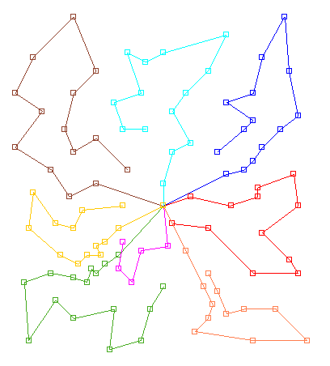
Distribution Planning Example
Solution of a Vehicle Routing Problem

Slide 46
Distribution Planning – The Challenge
Can you trust experienced truck drivers to draw solutions by hand?
This depends on the size (number of customers) and the hard or soft constraints (e.g. vehicle capacity, route duration, customer time windows etc) that we need to take into account.

Slide 47
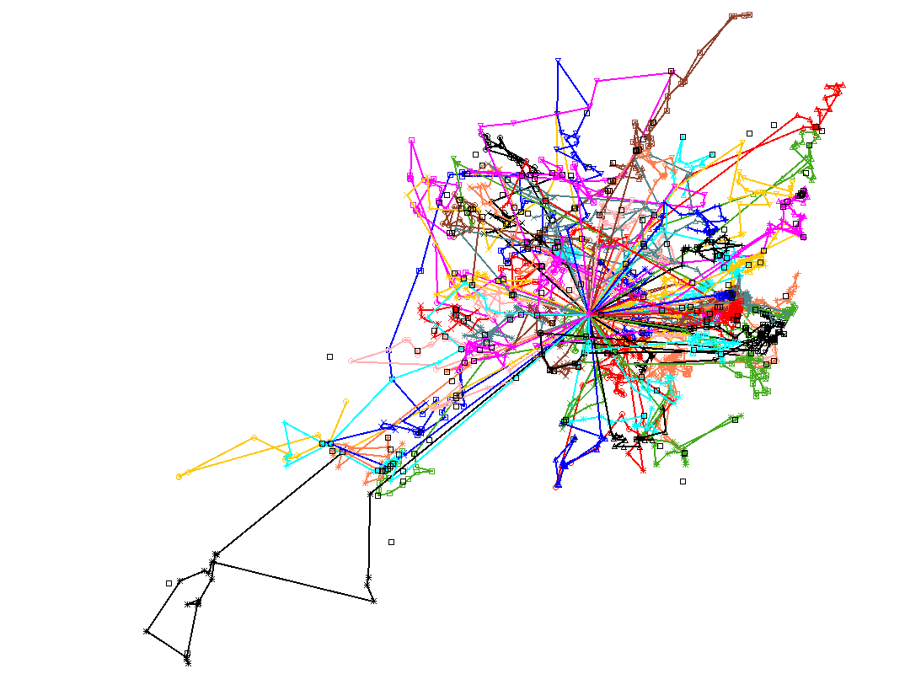
Distribution Planning – The Challenge
Even a small improvement of the daily vehicle routing plan (e.g. 1% less fuel consumption) can lead to HUGE savings in the long term.

Slide 48
Distribution Planning – Solution Methods
Can we use heuristics?
Not necessarily optimal, but fast.
Performance depends on problem.
Worst case performance may be very poor.
Can we use advanced math (e.g. exact mathematical programming algorithms)?
Optimal, but usually slow.
Difficult to model real life operational realities

Slide 49
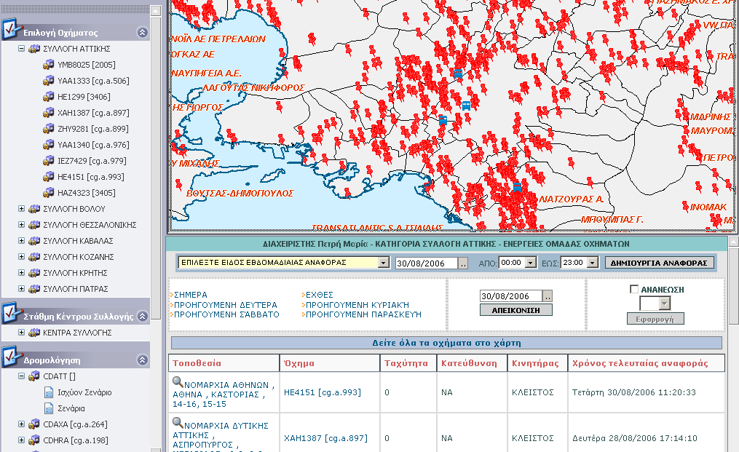
Even local problems can be very complex: A simple problem for a Vending Operator

Slide 50
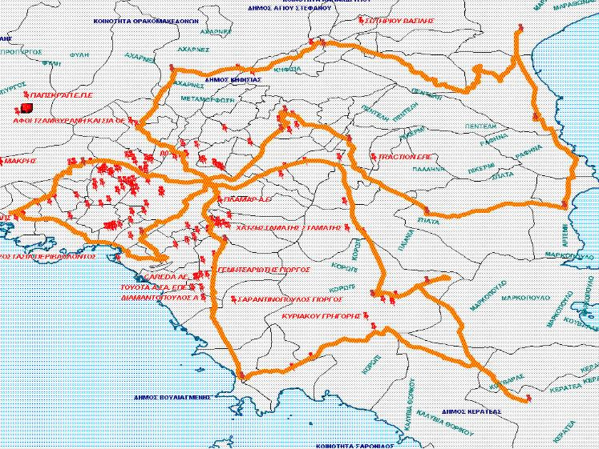
A combined Vehicle Routing /Distribution / Inventory Management problem

Slide 51
General Vehicle Routing Questions (e.g. FedEx)
How does FedEx get the minimized delivery cost?
How to short delivery time for higher customer satisfaction?
What types of vehicle does FedEx will use?
How to cover all customer demands?
How to respond to uncertain demands?
How to manage vehicle capacities?
How to manage loading/ unloading times?
How to manage driver shift?

Slide 52
Case 7: Suppliers Selection – Multiple Criteria
Analytical Hierarchy Process (AHP) is a common multi-criteria decision making method
It can be used to determine weights between criteria.
Crucial aspect in all factor scoring models
Although it only takes into account pairwise assessments, it eliminates factors that may increase the inconsistency

Slide 53
Analytical Hierarchy Process
Example:
Let 4 suppliers, i.e., S1, S2, S3 and S4
We will evaluate them according to 4 criteria, quality, cost, service and response
Evaluation of suppliers
Quality
S1
S2
S3
S4
Cost
S1
S2
S3
S4
Service
S1
S2
S3
S4
Response
S1
S2
S3
S4

Slide 54
Analytical Hierarchy Process
Α. Initial Matrix
 | Quality | Cost | Service | Response
Quality | 1 | 2 | 4 | 3
Cost | 1/2 | 1 | 3 | 3
Service | 1/4 | 1/3 | 1 | 2
Response | 1/3 | 1/3 | ½ | 1
Total | 25/12 | 11/3 | 17/2 | 9
Β. Normalized matrix
 | Quality | Cost | Service | Response Weight
Quality | 12/25 | 6/11 | 8/17 | 1/3 = 0,457
Cost | 6/25 | 3/11 | 6/17 | 1/3 = 0,300
Service | 3/25 | 1/11 | 2/17 | 2/9 = 0,138
Response | 4/25 | 1/11 | 1/17 | 1/9 = 0,105
The weights are the average values of each row and their sum equals 1

Slide 55
Α. Quality
 | S1 | S2 | S3 | S4
S1 | 1 | 5 | 6 | 1/3
S2 | 1/5 | 1 | 2 | 1/6
S3 | 1/6 | 1/2 | 1 | 1/9
S4 | 3 | 6 | 9 | 1
Weights | 0,297 | 0,087 | 0,053 | 0,563
Β. Cost
S1 | 1 | 1/3 | 5 | 8
S2 | 3 | 1 | 7 | 9
S3 | 1/5 | 1/7 | 1 | 2
S4 | 1/8 | 1/9 | 1/2 | 1
Weights | 0,303 | 0,573 | 0,078 | 0,046
C. Service
S1 | 1 | 5 | 4 | 8
S2 | 1/5 | 1 | 1/2 | 1/3
S3 | 1/4 | 2 | 1 | 5
S4 | 1/8 | 1/4 | 1/5 | 1
Weights | 0,597 | 0,140 | 0,214 | 0,050
D. Response
S1 | 1 | 3 | 1/5 | 1
S2 | 1/3 | 1 | 1/8 | 1/3
S3 | 5 | 8 | 1 | 5
S4 | 1 | 3 | 1/5 | 1
Weights | 0,151 | 0,060 | 0,638 | 0,151

Slide 56
Analytical Hierarchy Process
The final step is to calculate the total weighted multi-score for each supplier for all criteria:
The final rank of each supplier is the result of the weighted contribution w.r.t all criteria
In this particular example, suppler S1 (0,325) is the best, and must be selected.
 | Quality | Cost | Service | Response
S1 | (0,457)(0,297) + | (0,300)(0,303) + | (0,138)(0,597) + | (0,105)(0,151) = | 0,325
S2 | (0,457)(0,087) + | (0,300)(0,573) + | (0,138)(0,140) + | (0,105)(0,060) = | 0,237
S3 | (0,457)(0,053) + | (0,300)(0,076) + | (0,138)(0,214) + | (0,105)(0,638) = | 0,144
S4 | (0,457)(0,563) + | (0,300)(0,046) + | (0,138)(0,050) + | (0,105)(0,151) = | 0,294
 |  |  |  | Total | 1,000

Slide 57
Case 8: Aggregate Planning
Given a demand forecast for a planning horizon of 6 months, how to determine:
production and inventory levels,
the capacity level of each resource,
the prices and promotions,
… and many other key decision variables for each period,
such that the firm’s (supply chain’s) profit over the planning horizon is maximized?

Slide 58
Aggregate Planning
Given the aggregate forecast for all groups of products; the product specifications; the resource consumptions; and all relevant cost information…
Using linear programing, we can determine the optimal aggregate plan in terms of profits, costs or revenues.

Slide 59
Aggregate Planning
An example:
For different demand scenarios, we can also determine the optimal timing for promotions
Period, t | No. Hired, H_{t} | No. Laid Off, L_{t} | Workforce Size, W_{t} | Overtime, O_{t} | Inventory, I_{t} | Stockout, S_{t} | Sub-contract, C_{t} | Total Production, P_{t}
0 | 0 | 0 | 80 | 0 | 1,000 | 0 | 0
1 | 0 | 16 | 64 | 0 | 1,960 | 0 | 0 | 2,560
2 | 0 | 0 | 64 | 0 | 1,520 | 0 | 0 | 2,560
3 | 0 | 0 | 64 | 0 | 880 | 0 | 0 | 2,560
4 | 0 | 0 | 64 | 0 | 0 | 220 | 140 | 2,560
5 | 0 | 0 | 64 | 0 | 140 | 0 | 0 | 2,560
6 | 0 | 0 | 64 | 0 | 500 | 0 | 0 | 2,560
Source: Chopra & Meindl

Slide 60
General Aggregate Planning Questions (e.g. Toyota)
How to use the facilities of Toyota to maximize profit for whole operation process and optimize supply chain performance?
How to forecast customer demand for different automobile types, like body types, colors, packages needed?
What is the life cycle plan for each model?
How to decide the factory capacity to satisfy demands?
How to manage production rate, subcontracting, workforce, backlog, overtime, inventory and machine capacity level?
How to manage distribution network to achieve just in time supply?
How to set price and make promotions?
How to manage data flow among supplier, factory, dealer and customer?

Slide 61
Objectives of the course
This course studies key decision areas in supply chain design and operation
How to optimize the total value of the supply chain
How to measure the performance of the supply chain, and to identify the key drivers of performance
How to design a supply chain network
How to manage inventory
How to use data and apply the appropriate methods and tools in order to analyze trends, forecast customer demand, extract knowledge and make decisions
And more …

Slide 62
Course grading
Class Participation = 10%
Homework / Assignments = 40%
Final Project = 50%

Slide 63
Honor code
Cheating and plagiarism are forbidden
“Turn-it-in” software is used to evaluate student submissions
Learn how to properly cite others in your work

Slide 64
Materials for the course
Required Textbook
Chopra S. and Meindl P., Supply Chain Management: Strategy, Planning and Operation, 6th Edition, Pearson, 2012
Additional Reading
Fisher M. and Raman A., The new Science of Retailing: How analytics are transforming the supply chain and improving performance, Harvard Business Press, 2008
Feigin G., Supply Chain Planning and Analytics: The right product to the right place at the right time, Business Expert Press, 2011
Handfield R., Supply Market Intelligence: A managerial handbook for building sourcing strategies, Taylor and Francis Group, Auerbach, 2006
In class material
Web sources

Slide 65
Contact information
Prof. Panos Repoussis,
prepouss@stevens.edu

