Slide 1
11c. Sales and Operational Planning – Retail Analytics

Slide 2
Merchandise Depth Test
Test Scales

Slide 3
Merchandise Depth Test – Test Scales
Typical calendar for Fall season
Early Read
Test
Primary sales season
Closeouts
May
Aug
Sept
Dec
Jan
Feb
Goal is to predict total chain primary season sales from test sales (small batches of the new product in a few stores and measure how well they sell)
“Accurate Retail Testing of Fashion Merchandise: Methodology and Application”, Marshall Fisher and Kumar Rajaram, Marketing Science, Summer, 2000

Slide 4
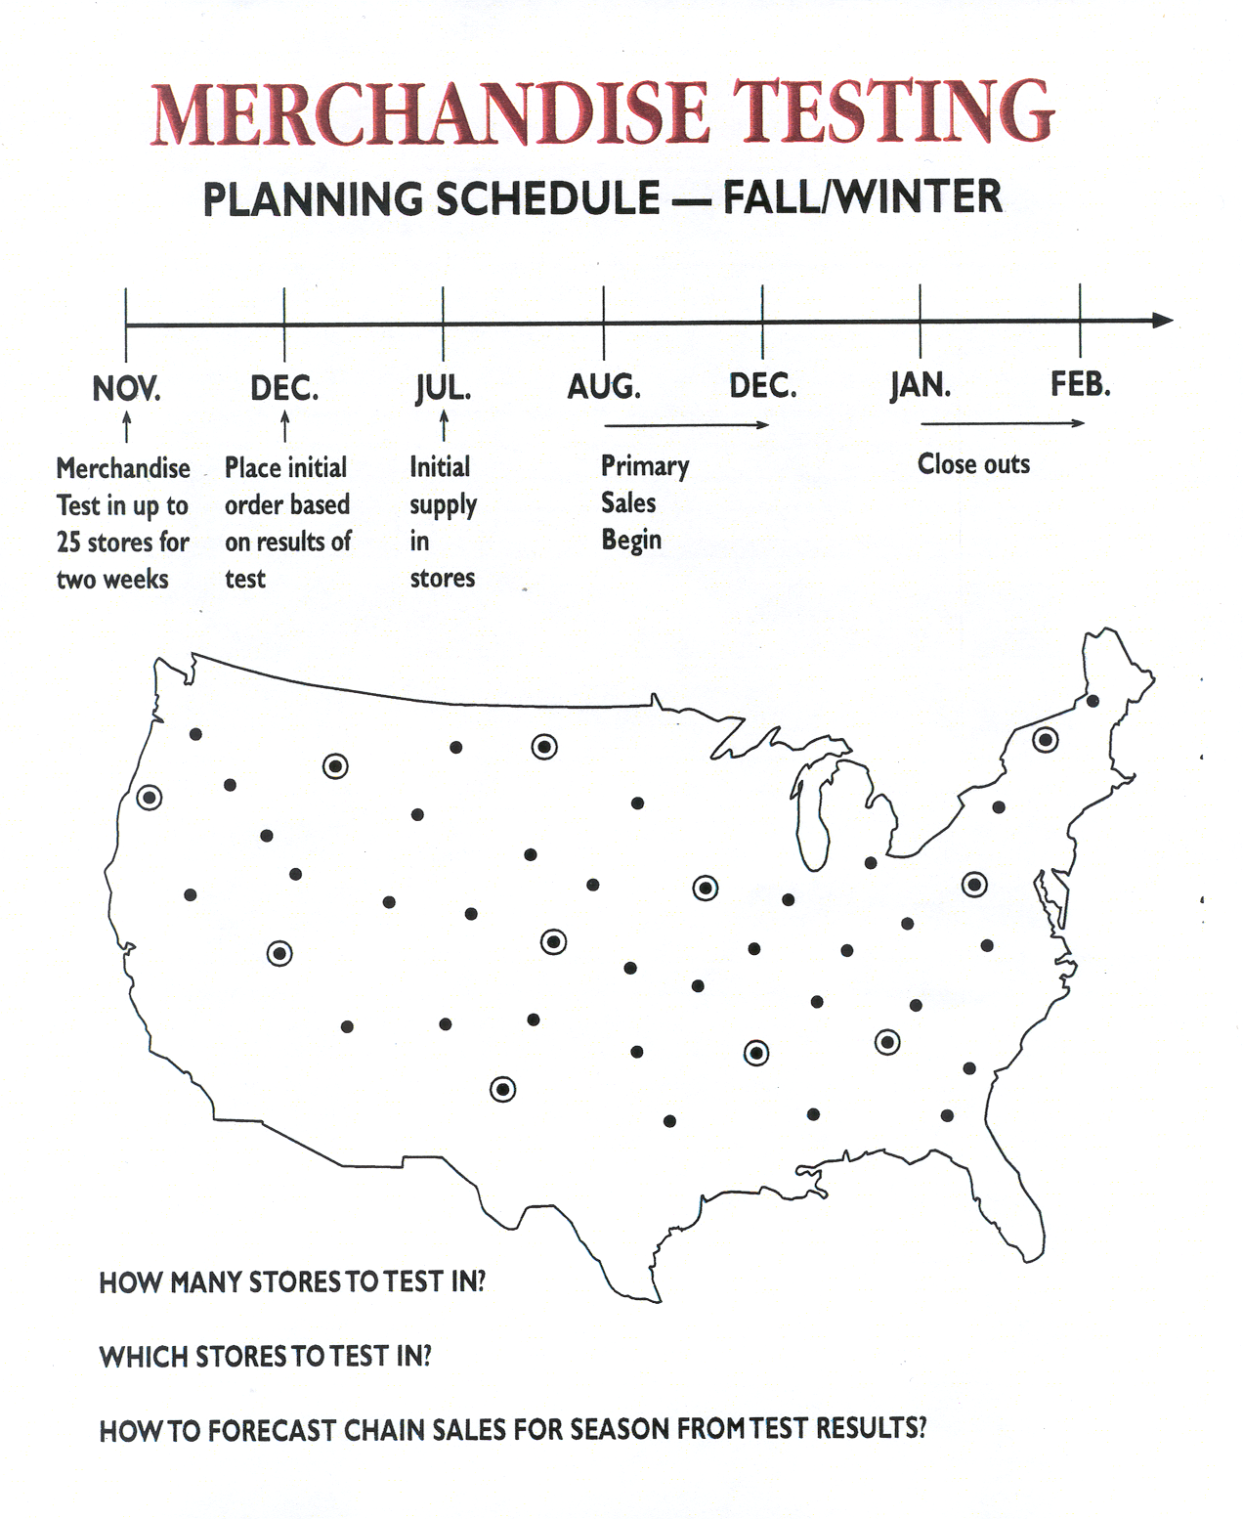
Merchandise Depth Test – Test Scales
Test design issues
Test Stores

Slide 5
Merchandise Depth Test – Test Scales
Typical Testing Process
Step 1. Choose 25 average stores e.g. average sales rate
Step 2. Place product in those stores for 4 weeks
Step 3. Forecast chain season sales as:
(stores in chain/25) (weeks in season/4) * Total test sales
Issue: This approach ignores seasonality factors, and demographics!

Slide 6
Merchandise Depth Test – Test Scales
Predicted vs actual using current process with 25 test stores at apparel retailer
Actual Sales
Predicted Sales

Slide 7
Merchandise Depth Test – Test Scales
Use store clustering to find representative test stores
Cluster stores based on similarity of sales mix. Use K-median clustering for this.
Choose most representative store from each cluster to be a test store.
Fit formula that most accurately predicts chain season sales from test store sales. Test stores aren’t weighted equally.
Can also predict sales of each cluster, and hence store sales

Slide 8
Merchandise Depth Test – Test Scales
Test store selection problem
Difference in sales mix between store i & store j
Season sales
of store i
= 1 if store j chosen as a test store
=1 if store i assigned to cluster represented by test store j

Slide 9
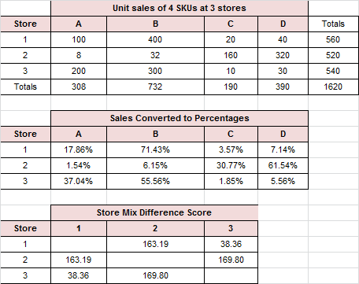
Merchandise Depth Test – Test Scales
Use sales percentages to calculate mix difference scores. For example, the mix difference between store 1 and 2 is |18-2|+|71-6|+|4-31|+|7-61|=162.

Slide 10
Merchandise Depth Test – Test Scales
Use sales history to create a formula that best predicts chain sales from test scales
Linear regression is a good approach.
Multiply each test store’s sales by a factor (the coefficient in the linear regression)
Factors are different for each store

Slide 11
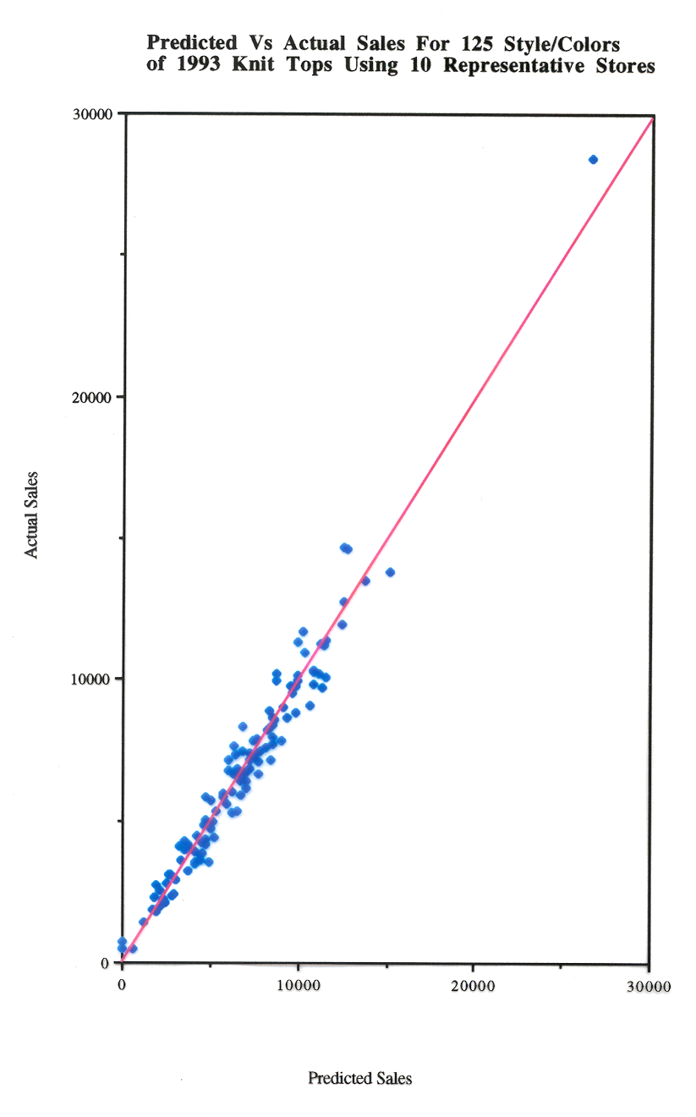
Merchandise Depth Test – Test Scales
Predicted vs actual using new method with 10 test stores at same retailer
Actual Season Sales
Predicted Season Sales

Slide 12
Optimal In-Stock Rates

Slide 13
Optimal In-Stock rates
What is in-stock rate of a product?
Percentage of stores in a week that didn’t run out of that product before replenishment arrives
Suppose that the in-stock rate of a product is 95% is this good or bad?

Slide 14
Optimal In-Stock rates
It is more accurate to use the sales-capture rate rather than the in-stock rate
Item | In-stock rate | Demand units per week | Price | Potential Revenue | Average lost revenue per week
A | 0.99 | 0.25 | 10 | 2.5 | 0.025
B | 0.99 | 0.5 | 9 | 4.5 | 0.045
C | 0.99 | 1 | 5 | 5 | 0.05
D | 0.99 | 0.4 | 15 | 6 | 0.06
E | 0.99 | 0.9 | 10 | 9 | 0.09
F | 0.75 | 10 | 100 | 1000 | 250
Totals |  |  |  | 1027 | 250.27
Average | 0.95
Sales capture rate / lost revenue | =1027/250.27 | 24.37%

Slide 15
Optimal In-Stock rates
How much the sales capture rate will increase if the in-stock rate increase by 1%?
Depends on the relative percentage of times that you lose none, one or more than one sale on that stock-out.
Customers can respond to a variety of ways if they encounter a stock-out:
No impact – they purchase a substitute
Lost sale - Decide they can do without the item or hey buy it elsewhere
Lost sales on an entire basket of items they planned to buy from your store
They do not return at all

Slide 16
Optimal In-Stock rates
How to choose the optimal order point for a single item based on two costs?
The cost of carrying the inventory
The lost margin due to stock-outs
If the season has 52 weeks and you replenish the item every week, then the optimal in stock rate can be determined as follows:
Optimal in-stock rate = 1- (cost of carrying in inventory an item for one year/52*item gross margin)
If replenishment deliveries are made at a frequency other than a week then 52 can be replaced with the number of delivery cycles

