Slide 1
11d. Sales and Operational Planning – Retail Analytics

Slide 2
Optimizing Prices and Markdowns

Slide 3
Optimizing Markdowns
Determine the depth and size of markdown for a product that maximizes your revenue (or maximize the profit since you already own the product).
Step 1 (Forecast). Estimate the sales lift that would result from a given markdown
Step 2 (Optimize). Determine the depth and timing of markdown to maximize revenue earned from the remaining inventory
Step 3 (Test). Improve the accuracy of the estimates in step 1 through price tests in which you vary the price to determine the sales response to particular markdowns

Slide 4
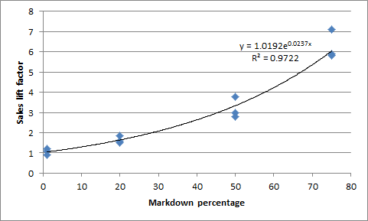
Optimizing Markdowns
Step 1. Estimate sales lift from historical data
Sales lift = e^(2.4*Markdown%), where e=2.7182

Slide 5
Optimizing Markdowns
Step 2. Find optimal depth and timing of markdown
Example: Initial buy of 3300 units of an item to cover demand for 16-weeks season. The item currently sales 100 units per week. Therefore, without markdown we will have 1700 units unsold units at the end. The regular price is 60$.
You want to examine 2 scenarios:
Markdown 3 weeks before the end of the season
Markdown 10 weeks before of the end of the season

Slide 6
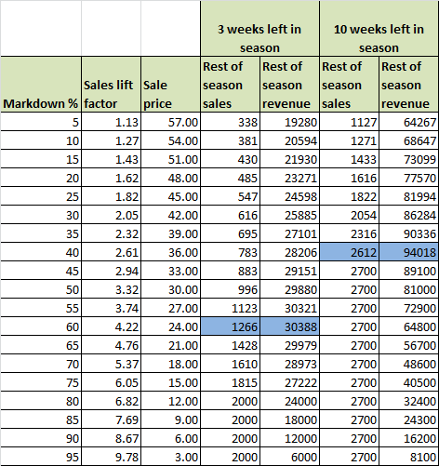
Optimizing Markdowns
60% for the 3 week
40% for the 10 weeks

Slide 7
Optimizing Markdowns
What is the optimal timing?
3 weeks left in season revenue:
13*100*60 + 30388 = $108388
10 weeks left in season revenue:
6*100*60 + 94018 = $112018
Best rule: Clear up the problem as soon as you realize that you bought too much

Slide 8
Optimizing Markdowns
Step 3. Improve the process (if needed) with price testing.
Example: A product costs 18$. We test 3 different prices 24.99, 29.99 and 34.99 and we observed the total sales for a given period.

Slide 9
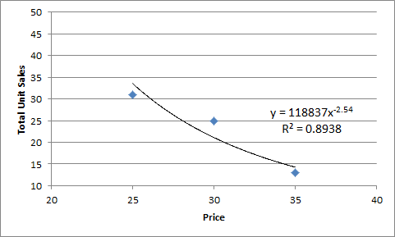
Optimizing Markdowns
1. We determine the demand curve for the different prices and based on that we determine the optimal price

Slide 10
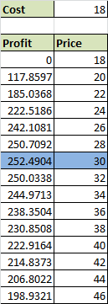
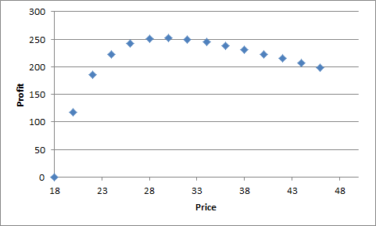
Optimizing Markdowns
2. Based on the demand curve we determine the optimal price.

