Slide 1
Excel Solver Tutorial
BI&A 674

Slide 2
Install
To use the Solver Add-in, you first need to load it in Excel.
Click the Microsoft Office Button, and then click Excel Options.
Click Add-Ins, and then in the Manage box, select Excel Add-ins.
Click Go.
In the Add-Ins available box, select the Solver Add-in check box, and then click OK.
Tip If Solver Add-in is not listed in the Add-Ins available box, click Browse to locate the add-in.
If you get prompted that the Solver Add-in is not currently installed on your computer, click Yes to install it.
After you load the Solver Add-in, the Solver command is available in the Analysis group on the Data tab.
If you don’t have solver in add-in, you should download excel solver by searching google. And then install it by yourself.

Slide 3
How to Use Solver
Step 1:

Slide 4
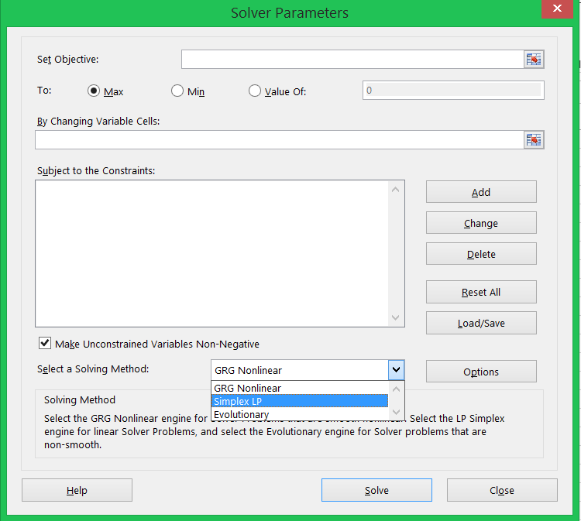
How to Use Solver
Step 2:
choose the cell of objective
Max: maximum objective
Min: minimum objective
Value of: define a value that you want
Choose cells of decision variables
Define Constraints
Choose solving method
Finally click solve it will give you optimized result

Slide 5
Example:
Furnco Manufactures desks and chairs. Each desk uses 4 units of wood and each chair uses 3 units of wood. A desk contributes $40 to profit and a chair contributes $25. Marketing restrictions require that the number of charis produced be at least twice the number of desk produced. There are 20 units of wood available.
Use Solver to maximize Furnco’s profit.

Slide 6
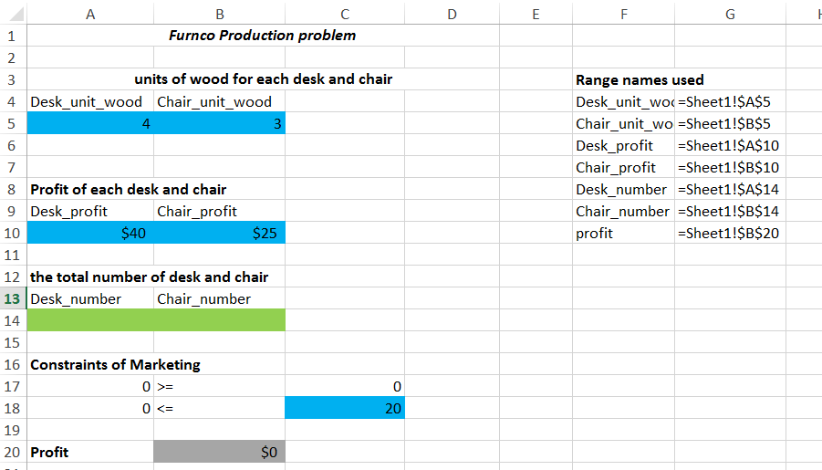
Example Cont.
Decision Variables: automatically
get after running solver
Constraints
Objective : automatically get after running solver

Slide 7
Example Cont.
From the sheet, blue parts give use the units that need by a desk and a chair. We also can know the total units of a wood available. Furthermore, the profit that contribute by a desk and a chair separately.
The Model Approach like:
x1 and x2 represent decision variables
Maximize: z=40x1+25x2
4x1+3x2<=20;
x2>=2x1
x1>=0; x2>=0

Slide 8
Example Cont.
According to Model Approach:
Define B14 = B17;
B18 =A5*A14+B5*B14
B20 =A10*A14+B10*B14
Then run Solver

Slide 9
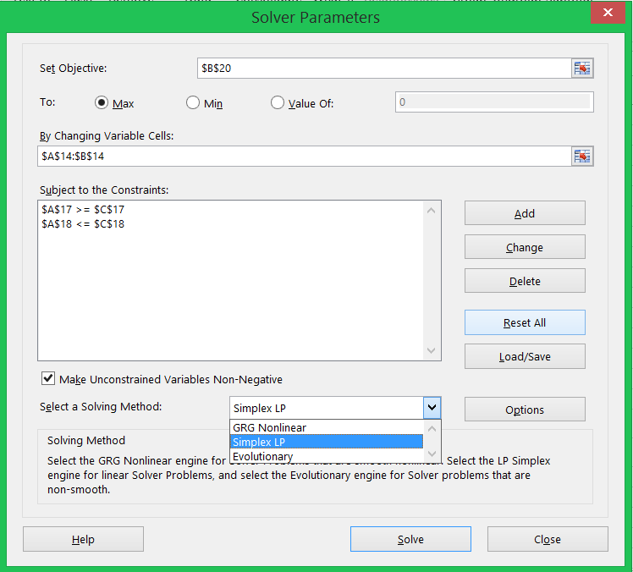
Example Cont.
Choose objective cell
I want maximum profit
Choose decision variables cells
Define constraints
I choose SimplexLP
Finally, click Solve

Slide 10
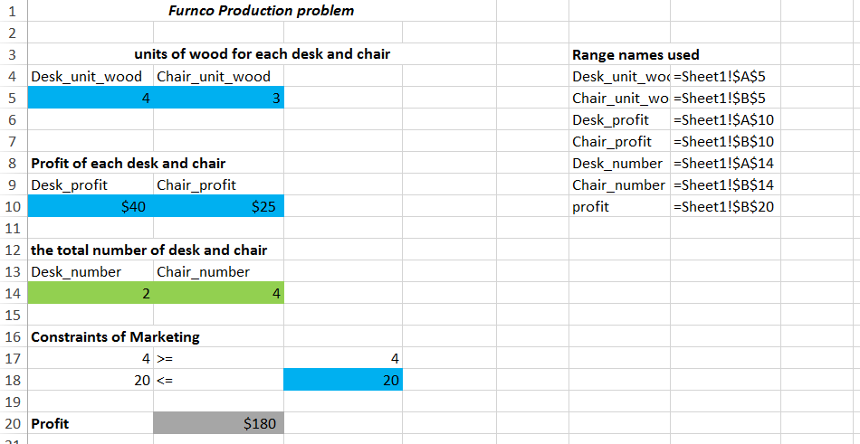
Example Cont.
Result:

