Slide 1
GAMS Tutorial
BI&A 674

Slide 2
Introduction
GAMS Website
www.gams.com
http://gams.com/download/ ← Download here
Run setup.exe
Use the Windows Explorer to browse the CD and double click setup.exe
After installing GAMS there is on you desktop

Slide 3
Start GAMS
Start GAMS by selecting:
Start → All Programs → GAMS → GAMSIDE

Slide 4
Create New GAMS Project
Choose from the GAMSIDE:
File → Project → New project

Slide 5
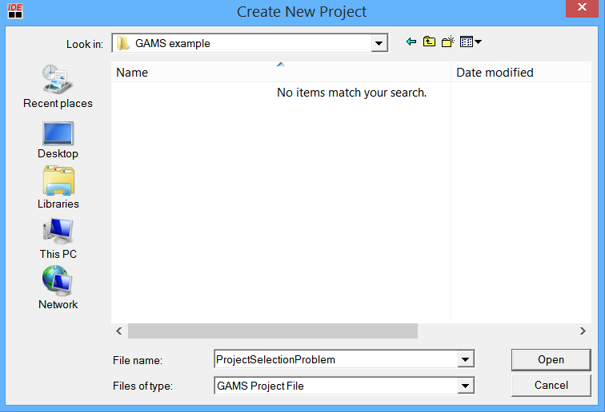
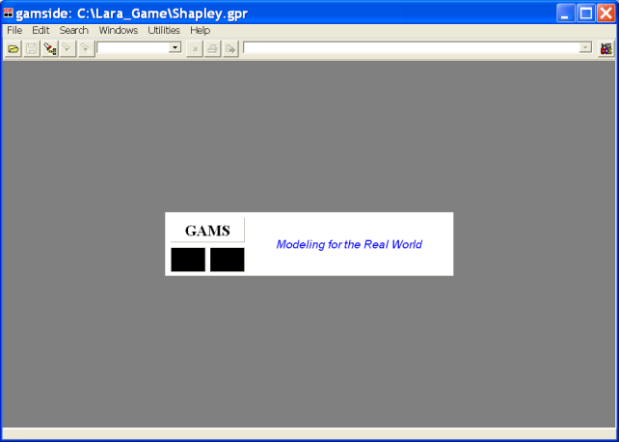
Name New GAMS Project
You can save any folder that you want
Create a new directory by pressing the “folder” icon.
Name the new folder “GAMS Example”
Double click on “GAMS Example” folder
Type “ProjectSelectionProble” in the “File Name” box
Press Open

Slide 6
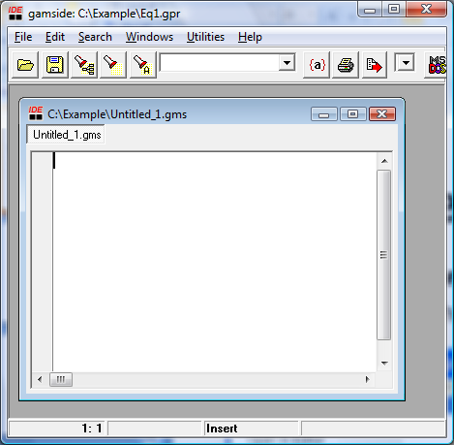
Create New GAMS Code File
Select: File → New
You should see the new file “Untitled_1.gms”

Slide 7
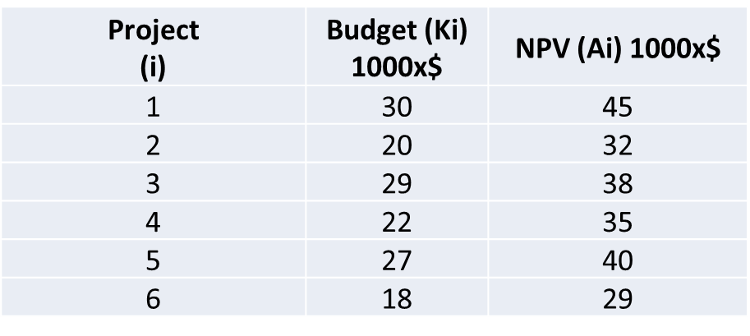
Example 1
A Project Portfolio Example
Available Budget 100000$
Project Specifications:

Slide 8
Project Portfolio Example (Cont.)
Constraints and Limitations
We cannot exceed total budget
Projects 1 and 5 can only be selected as a pair, we cannot select separately project 1 or project 5.
We can select either project 3 or project 4, but we cannot select both of them
We cannot select more than 3 projects
We can select project 6, only if we have also selected project 3
Objective
Select the projects that maximize the total NPV according to the constraints and limitations

Slide 9
Project Portfolio Example (cont.)
Solution
Binary Decision Variables: X1, X2, X3, X4, X5 and X6
These are variable can only take values 0 or 1. For example, if project 1 is selected then X1=1; otherwise X1=0.
Model
max(X1A1+X2A2+X3A3+X4A4+X5A5+X6A6)
X1K1+X2K2+X3K3+X4K4+X5K5+X6K6 <= 100
X1 = X5
X3+X4 <= 1
X1+X2+X3+X4+X5+X6 <= 3
X6 <= X3

Slide 10
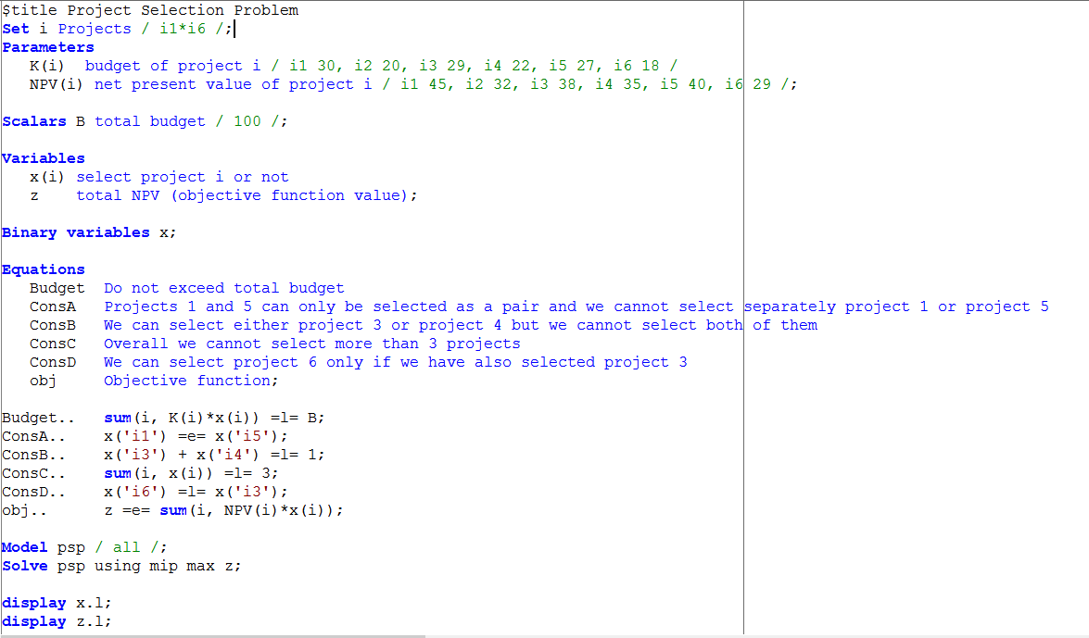
Enter GAMS Code

Slide 11
GAMS Code Explanation (define set)
Sets are the basic building blocks of a GAMS model, corresponding exactly to the indices in the algebraic representation of models.
For this code, it means we give one set and named it as i. I also assigned member to set as {i1, i2, i3, i4, i5, i6}

Slide 12
GAMS Code Explanation (Define Parameters)
This statement declares the existence of two parameters, give them name k and NPV, and declares their domains to be i. (domains is the set)
The statement also gives documentary text for each parameters and assigns values of K(i) and NPV(i) for each element of i.
A Scalar is regarded as a parameter that has no domain.

Slide 13
GAMS Code Explanation (define variables)
This statement results in the declaration of a project variable for i.
Z variable is declared without a domain because it is a scalar quantity.
Once declared, every variable must assign a type. For here we define x as binary variables. (Tables shows permissible variable types)

Slide 14
GAMS Code Explanation (Define Equation)

Slide 15
GAMS Code Explanation (Define Equation) Cont.
Equation must be declared and defined in separate statements.
Equation Definition
The name of the equation being defined
The domain
Domain restriction condition
The symbol ‘..’
Left-hand-side expression
Relational operator: =l=, =e=, or =g= (means less than, equal to, greater than)
Rgith – hand expression

Slide 16
GAMS Code Explanation (State Model)
This statement may seem superfluous, but it is useful to advanced users who may create several models in one GAMS run
All means it include all previously defined equations.

Slide 17
GAMS Code Explanation (State Solve)
The format of the solve statement is as follow:
The key word solve
The name of the model to be solved
The key word using
The available solution procedure. Three common used list
LP for linear programming
Mip for mixed integer programming
Nlp for non linear programming

Slide 18
GAMS Code Explanation (State display)
This statement will call for a printout of the final levels x.l and z.l
.l means level or primal value.

Slide 19
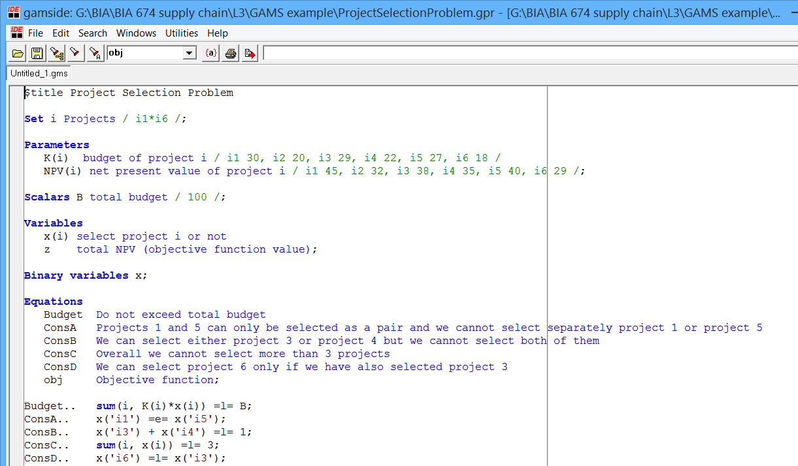
Run the Model
Select: File → Run, or Press the red arrow button

Slide 20
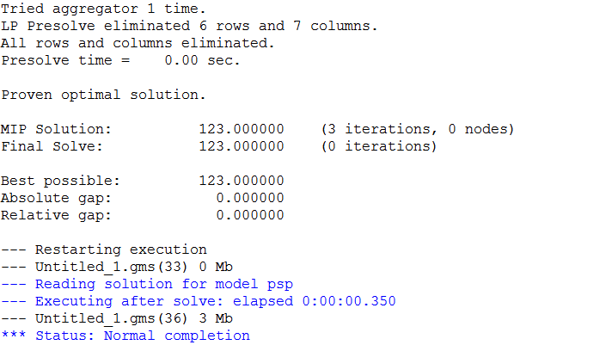
GAMS Model Results
Optimal solution

Slide 21
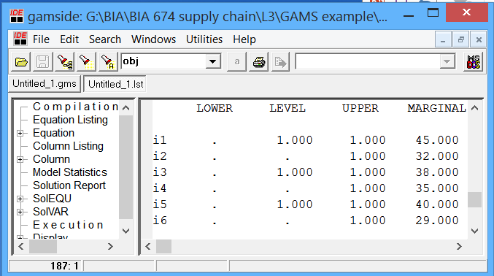
Viewing Results File
After running .gms file, it will automatically build a .lst file. You can find result from .lst file. If there are some mistakes, .lst file will also tell you what kind of mistake that you make.
.lst file
.gms file

Slide 22
Example 2 (linear programming)
2 supply plants, 3 markets and 1 commodity (book).
Given: unit costs of shipping (c = $90 per case per thousand miles)
How much to ship to minimize total transportation cost
Distances
 | Markets
Plants | New York | Chicago | Topeka | Supply
Seattle | 2.5 | 1.7 | 1.8 | 350
San Diego | 2.5 | 1.8 | 1.4 | 600
Demand | 325 | 300 | 275

Slide 23
Project Portfolio Example (cont.)
Solution
Binary Decision Variables: X_{i,j} (amount to ship from plant I to maket j)
Model
Observe supply limit at plat i:
∑_{j} x_{ij} ≤ supply of commodity of plant I
Satisfy demand at market j:
∑_{i} x_{ij} ≥ demand for commodity at market j
Objective Function:
Minimize ∑_{i} ∑_{j} c x_{ij}

Slide 24
GAMS Code

Slide 25
GAMS Code (cont.)

Slide 26
Example 3 (nonlinear programming)
Model:
$\min_{x1,x2,x3,x4}{{(x1−1)}^{2}}$ + ${(x1 −x2)}^{2}$ + ${(x2−x3)}^{3}$ + ${(x3−x4)}^{4}$ + ${(x4−x5)}^{4}$
Subject to
x1 + x2² + x3³ = 3$√2$ + 2
x2 – x3² + x4 = 2$√2$ - 2
x1x5 = 2
x1>=-1, x2 >=2, x3 >=1, x4>=-2, x5>=-2

Slide 27
GAMS Code

Slide 28
Additional Resource:
http://www.gams.com/docs/document.htm

